Slide 1
Energy, Power and People Connections to the NYS Capital Region
Kenneth A. Connor
Education Director
Smart Lighting ERC

Slide 2
Goals
Introduction and Overview
Why are We Here?
Three Giants of Technology
Demos

Slide 3
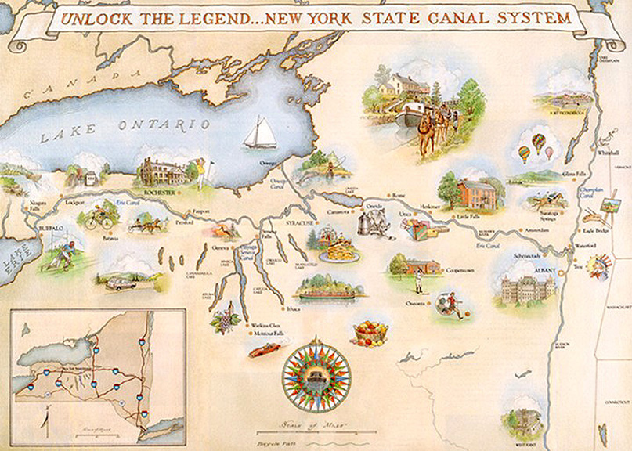
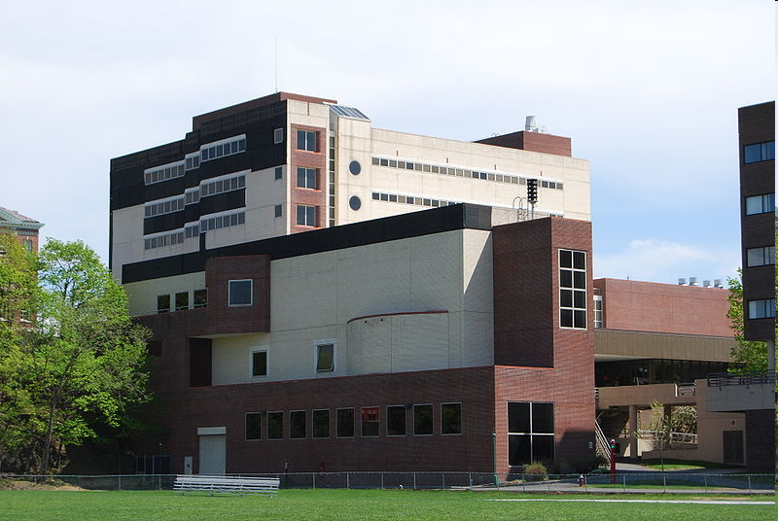
Why Are We Here?

Slide 4
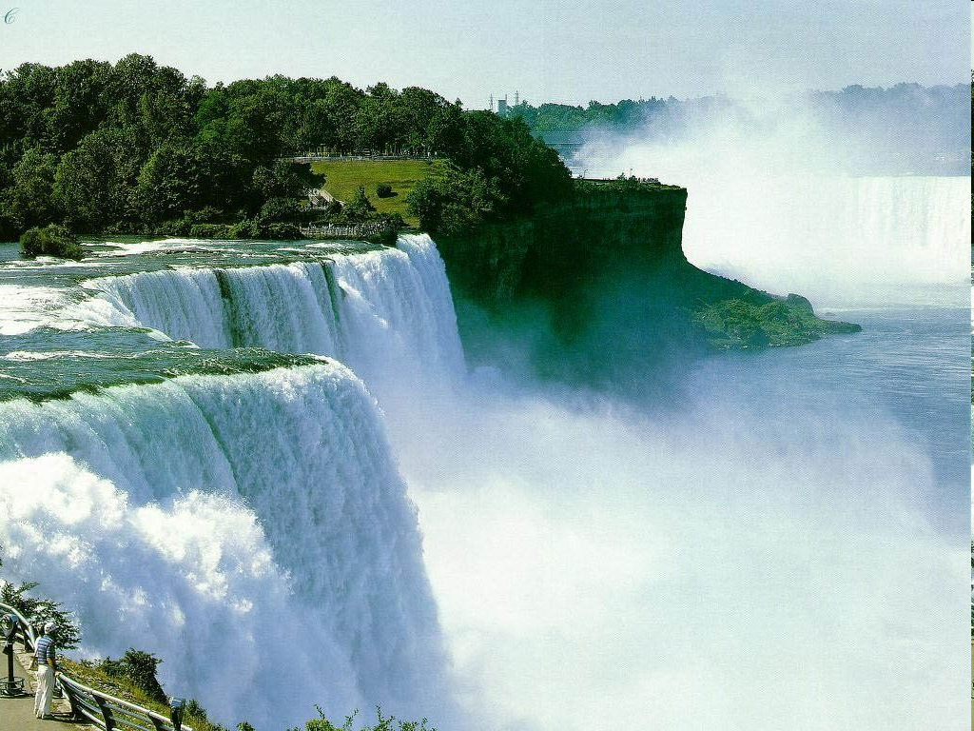
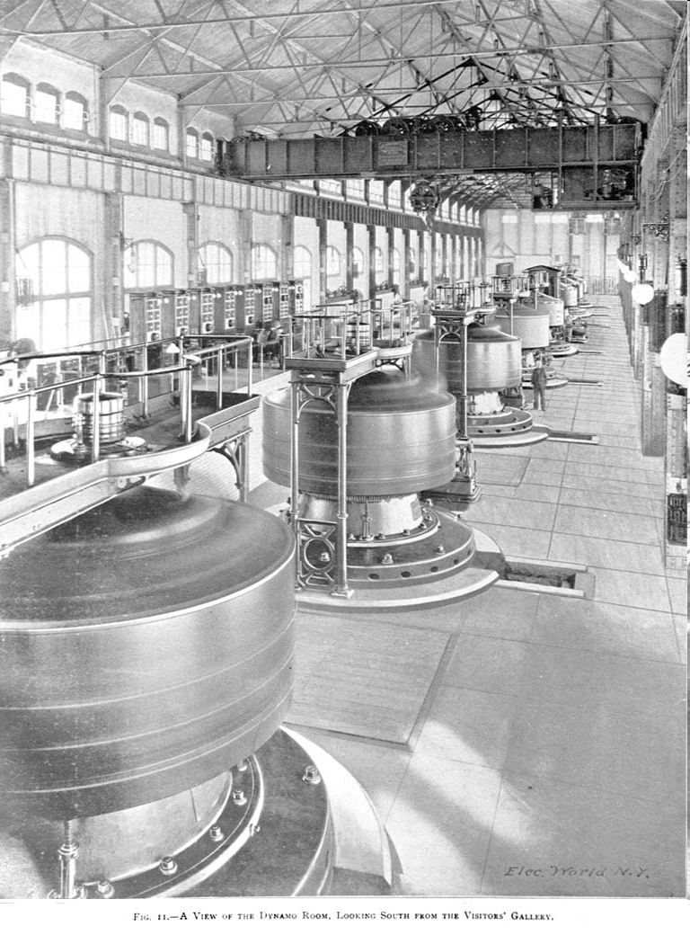
Also

Slide 5
Three Giants of Technology
Joseph Henry & the Dawn of the Information Age
A bit of his story
What did he do?
Alan Dumont & Measurement
A bit of his story
What did he do?
Ted Hoff & Making Everything Smart
A bit of his story
What did he do?
Addendum

Slide 6
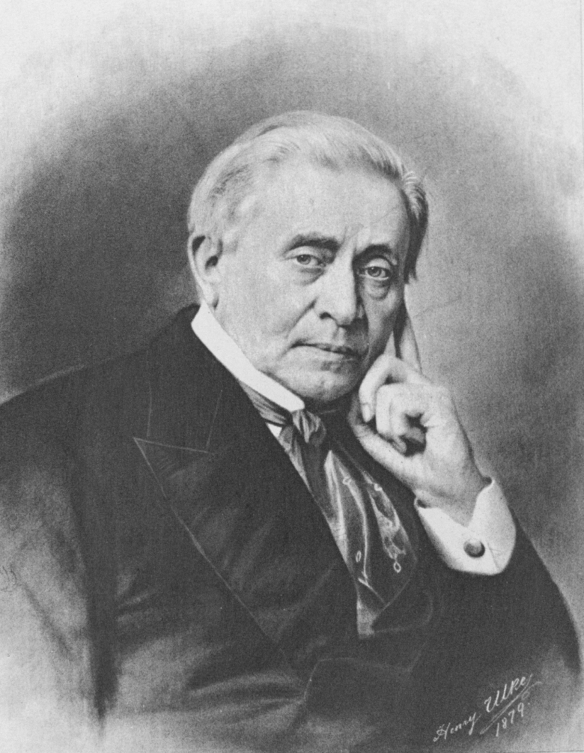
Joseph Henry
http://maps.google.com look up Albany, NY

Slide 7
Joseph Henry
Born in Albany, December 17, 1797
Grew up in Galway with his grandmother after his father died
1819 Entered Albany Academy
1826 Professor at Albany Academy
1832 Professor at Princeton
1846 First Secretary of the Smithsonian
1863 Co-founder and 2nd President of NAS
Died, May 13, 1878

Slide 8
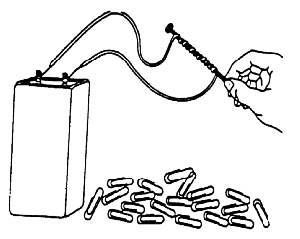
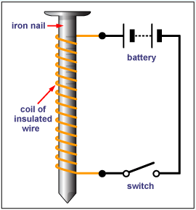
Joseph Henry
What is one of the keys to making a powerful electromagnet?
Insulation
Electromagnet

Slide 9
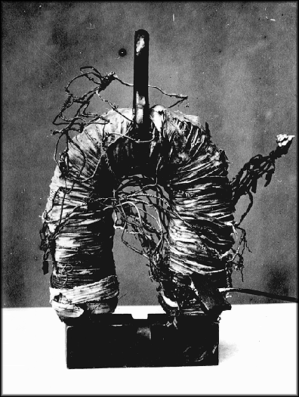
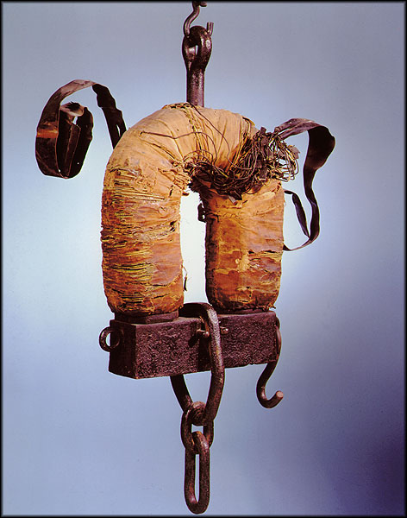
Joseph Henry
His key practical contribution to the electromagnet – how did he do it?

Slide 10
Joseph Henry
In 1820, Danish physicist Hans Christian Oersted had discovered that the flow of an electric current produced a magnetic field around the wire. This amazed scientists and many, including Henry and Faraday, began to experiment with magnetism. In 1829 Henry learned that William Sturgeon had built an electromagnet that could lift nine pounds. This was quite remarkable, but Henry believed he could create a magnet that was much stronger. The secret was to wrap more wire around the iron core, overlapping the levels. However, wire in that era was not insulated, so wrapping one level over another caused a short circuit. Henry got around the problem by the laborious process of insulating the copper wire by hand, using strips of his wife's silk petticoats.

Slide 11
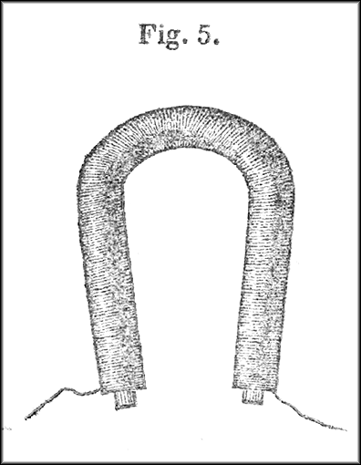
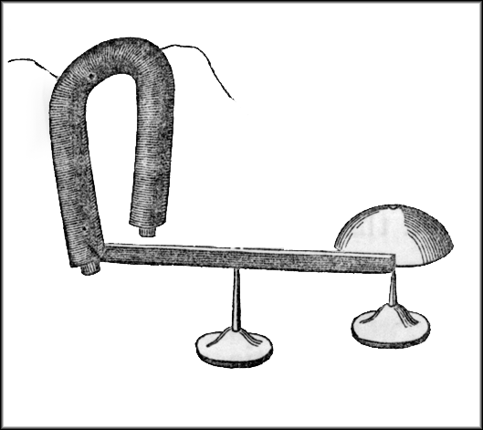
Joseph Henry
He recognized that the magnet could be the key part of a long distance signaling device – this became the telegraph

Slide 12
Joseph Henry
Simple idea – properly insulate the wires so that many turns could be added to a magnet – which he called intensity magnets
Saw the potential of the more powerful device as the beginning of long distance communication
Also demonstrated that a motor could be made, although his did not turn
His work made motors & generators and essentially all electric power equipment possible

Slide 13
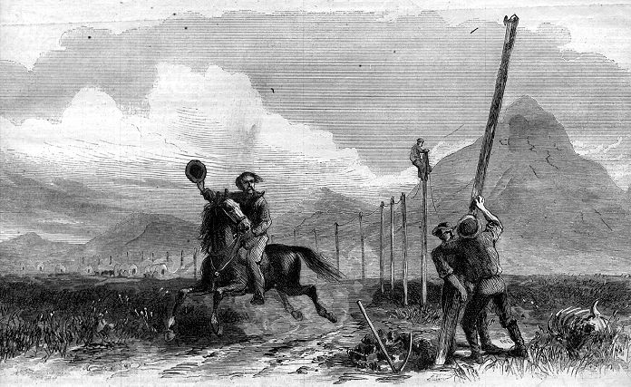
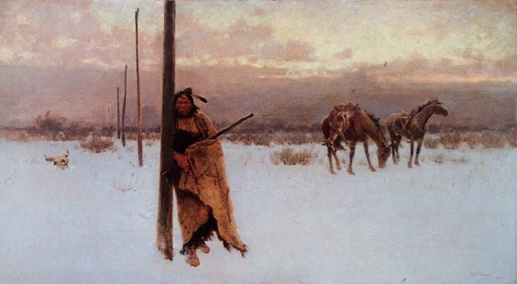
Telegraph
Send messages to people over very long distances
What can we do with a strong magnet?

Slide 14
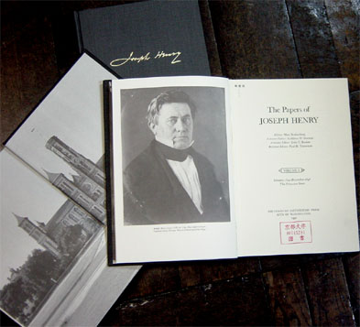
Joseph Henry Inspired Demos
Electromagnet with insulation
Coin Flipper
Coil Launcher
Simple motor
Cow Magnet
Generator?

Slide 15
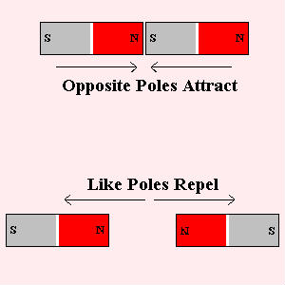
North and South Poles
Magnets also attract metal (iron or steel)

Slide 16
Coin Flipper
Launch Rockets Without Rocket Fuel?
Coin
Electromagnet

Slide 17
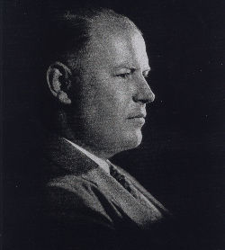
Alan Dumont

Slide 18
Alan Dumont
January 29, 1901 born in Brooklyn, NY
In 1911 had polio – spent a lot of time reading
BSEE at RPI 1924
1931 Started his company which ultimately marketed oscilloscopes, televisions and became one of the first TV networks
Died November 14, 1965

Slide 19
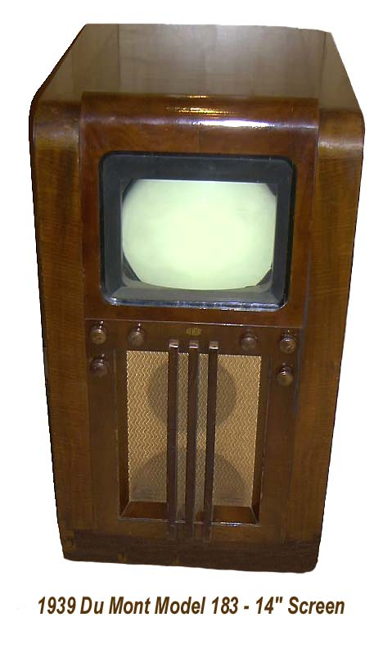
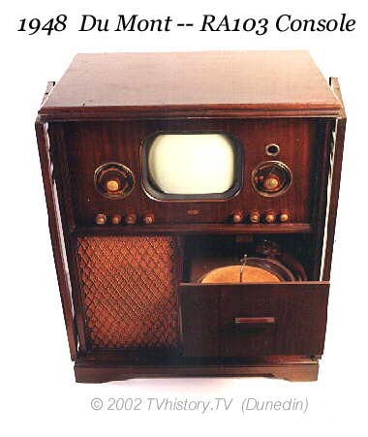
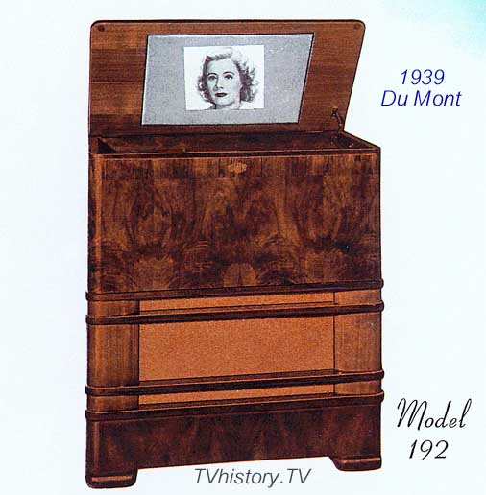
Alan Dumont
http://www.tvhistory.tv/

Slide 20
Alan Dumont
Developed the first practical CRT (previous versions lasted only 10s of hours)
First company to market home TV receiver in 1938
Dumont network until 1956 – It could not compete with radio networks (poorly funded)
Broadcast Jackie Gleason, first sporting events, but shows were bought by big 3 networks
Dumont was one of broadcastings first millionaires

Slide 21
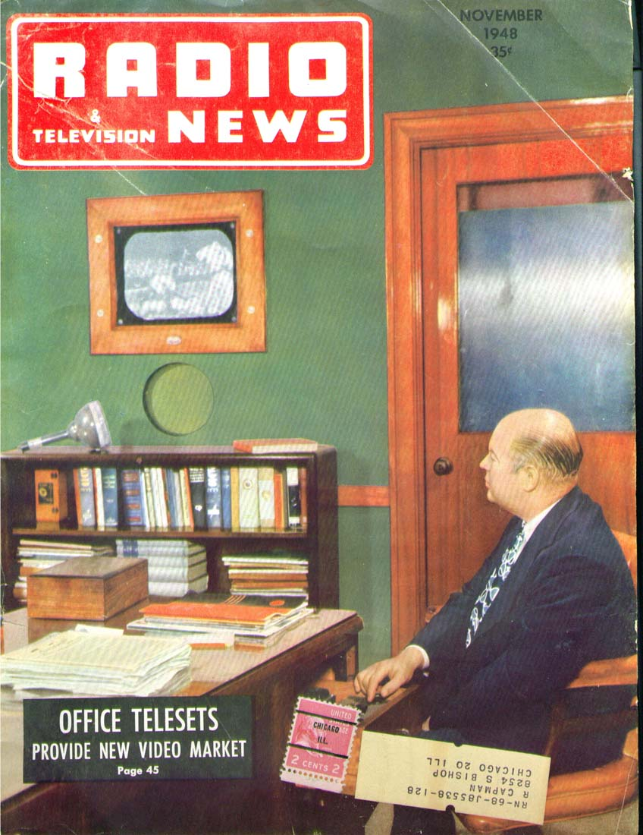
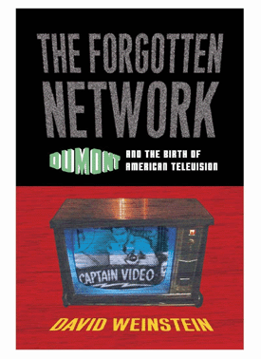
Alan Dumont

Slide 22
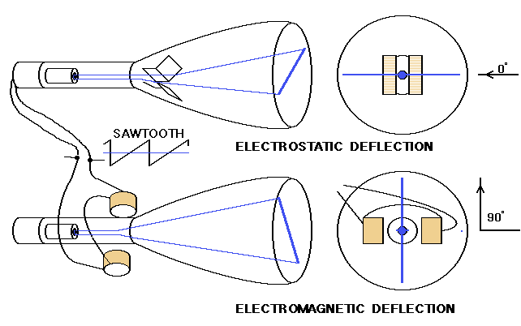
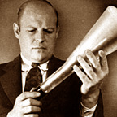
Displays: CRT
In a CRT, an electron beam excites the phosphor
The beam is directed to a spot on the surface using sweep plates

Slide 23
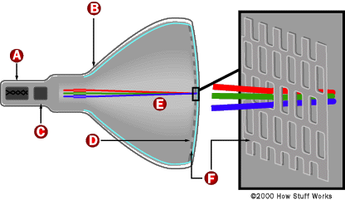
Displays: CRT
Three separate electron guns are required to produce a color picture

Slide 24
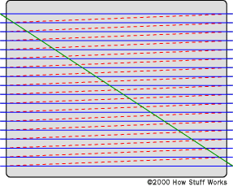
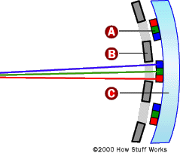
Displays: CRT
At the left is the layout of the mask and phosphors
At the right is the scanning sequence

Slide 25
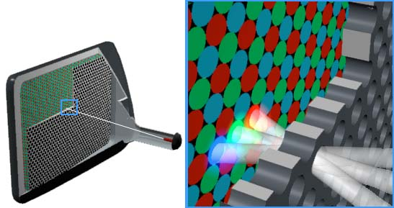
Displays: CRT
A large variety of configurations are used by manufacturers
Look carefully at the screen of your TV

Slide 26
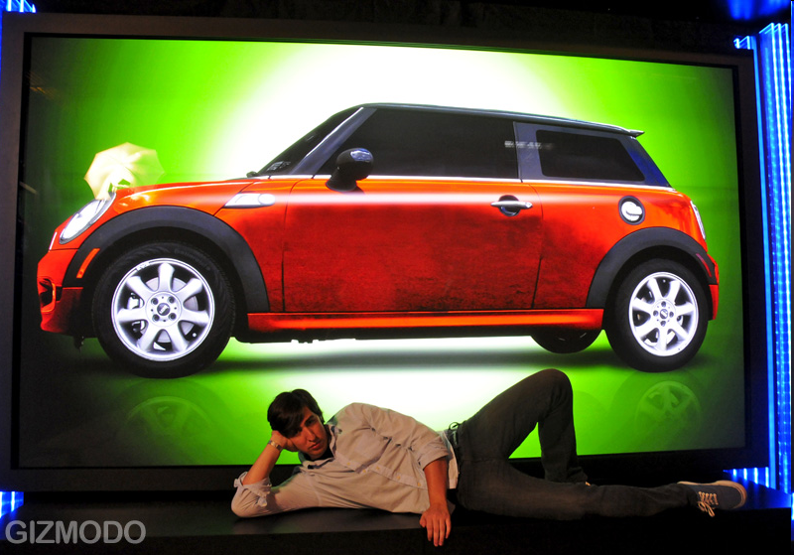
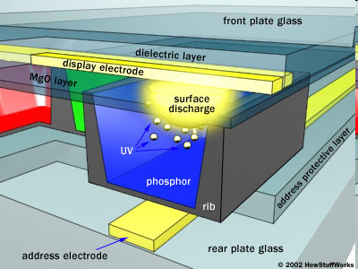
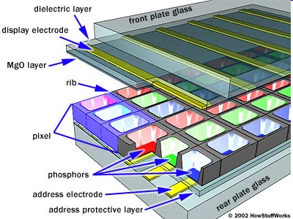
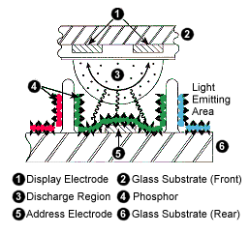
Plasma Display
150 Inches
Each Discharge Cell Creates UV Radiation from a Plasma Discharge that Activates a Phosphor

Slide 27
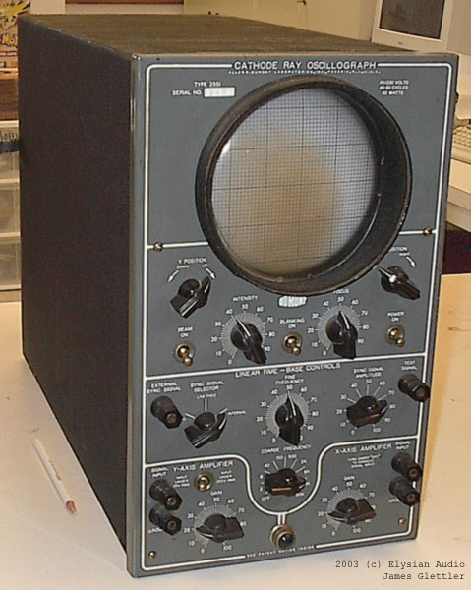
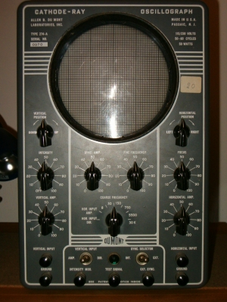
Alan Dumont
Inventor of the practical CRT which led to the oscilloscope.
Dumont dominated the ‘scope market for many years.

Slide 28
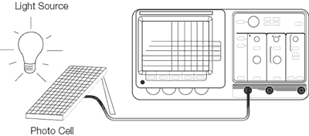
Alan Dumont
What does a ‘scope permit us to do?
Monitor the electrical signals in a power system or any other electrical system
Scope Simulation http://www.virtual-oscilloscope.com/simulation.html

Slide 29
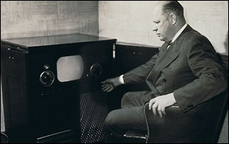
Alan Dumont Inspired Demos
CRT examples
Making measurements
Your job.

Slide 30
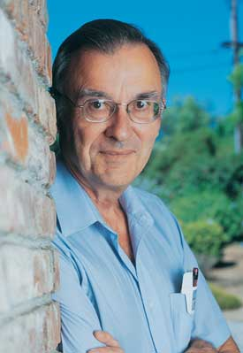
Ted Hoff
"Ted" Hoff's career as an engineer began long before he invented the microprocessor at Intel. At age 15, he won a trip to Washington, D.C., and a $400 scholarship from the Westinghouse Science Talent Search. As a sophomore at Rensselaer Polytechnic Institute in Troy, N.Y., he won points (and patents) for designing two circuits for the General Railway Signal Co., where he worked summers and college holidays as a lab tech. One circuit detected trains through the audio frequencies transmitted along the railway track. Another absorbed energy to protect against lightning.

Slide 31
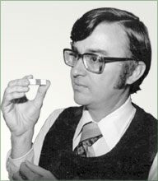
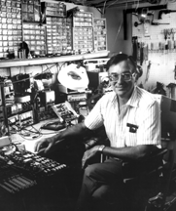
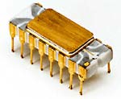
Marcian E. (Ted) Hoff
1937 Born in Rochester NY
1958 EE Degree from RPI
1962 PhD from Stanford
1971 Invented the Microprocessor (Intel 4004)

Slide 32
Ted Hoff
In 1968 he joined the fledgling Intel Corporation (he was employee number 12) where he was the first to recognize that Intel’s new silicon technology might make a single-chip central processor possible if a sufficiently simple architecture could be developed. Hoff developed such an architecture with just over 2,000 transistors.
He invented the first electronic circuit that combined complicated computer functions on a single silicon chip, earning him recognition as the “father of the microprocessor.” This single chip had as much computing power as the first electronic computer, ENIAC, which in 1946 filled a room. The microprocessor created a revolution in computing

Slide 33
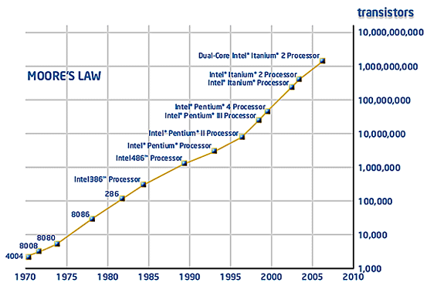
How Many Transistors in a Processor?

Slide 34
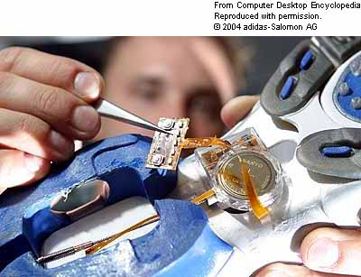
Embedded in a Shoe! The microprocessor embedded in this adidas running shoe calculates the pressure between the runner's foot and the ground five million times per second and continuously changes the cushioning to match an adjustable comfort level. The computer controls a motor that lengthens and shortens a cable attached to a plastic cushioning element. (Image courtesy of adidas-Salomon AG.)

Slide 35
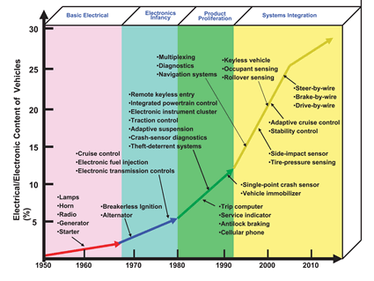
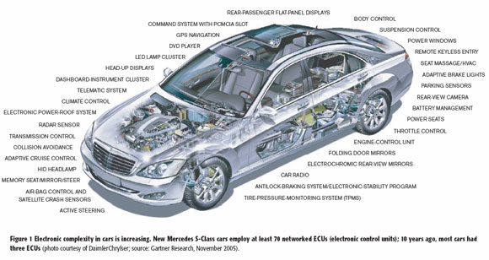
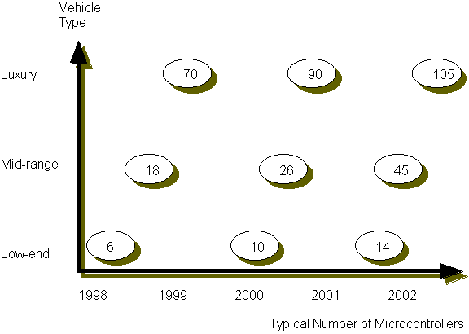

Slide 36
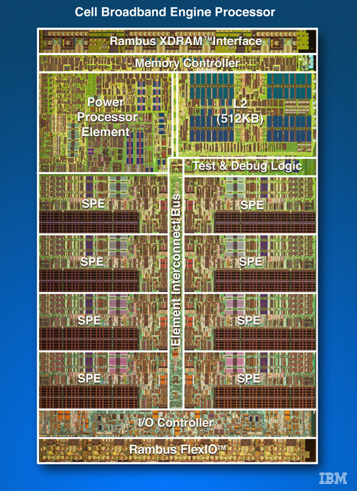
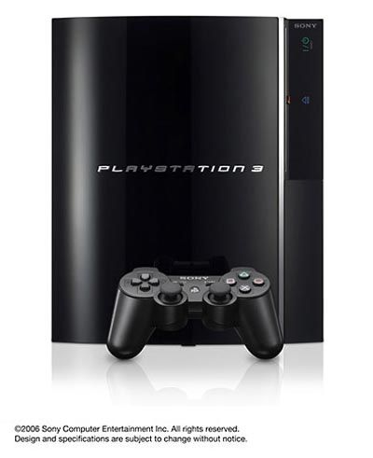
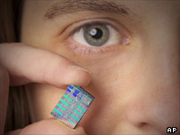
What is the Cell Processor & What is it used for?
http://www.gamasutra.com/features/20060713/turley_01.shtml
Cell combines a general-purpose Power Architecture core of modest performance with streamlined coprocessing elements which greatly accelerate multimedia and vector processing applications, as well as many other forms of dedicated computation.

Slide 37
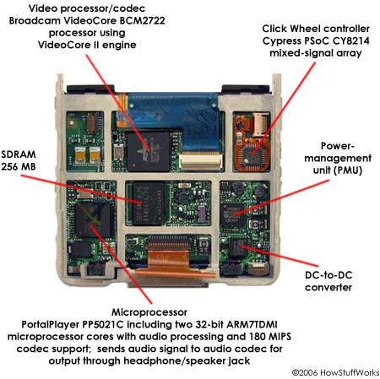
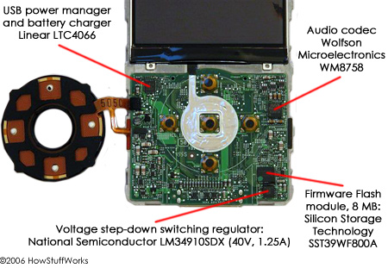
Ted Hoff Inspired Demos
Some mysterious/funny devices
Machines can talk
What is this?

Slide 38
What do the Three Have in Common?
From New York
Educated in Capital District
Very Bright
Could find Creative Ideas to Help Advance the State of Some Device or Concept
&?
They were/are all men

Slide 39
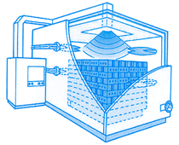
Women in Engineering
Ceralink – RPI Tech Park
Dr. Holly Shulman, President, Material Scientist
Patricia Strickland, Business Manager
Morgana Fall, Operations Engineer
Shawn Allan, Senior Materials Engineer
Inessa Baranova, Technical Specialist
Nick Vandervoort, Co-Op Engineer
Microwave Assisted Furnace
http://ceralink.com/index.htm

Slide 40
Note the significantly reduced energy consumption when microwave assisted heating is utilized

Slide 41
Microwave Oven Demo
What can we do with these?

Slide 42
Online References
Joseph Henry
http://en.wikipedia.org/wiki/Joseph_Henry
http://inventors.about.com/library/inventors/bljosephhenry.htm
http://www.nndb.com/people/671/000096383/
http://etcweb.princeton.edu/CampusWWW/Companion/henry_joseph.html
http://siarchives.si.edu/history/jhp/site.htm
http://siarchives.si.edu/history/jhp/joseph14.htm
http://www.madehow.com/inventorbios/75/Joseph-Henry.html

Slide 43
Online References
Alan Dumont
http://en.wikipedia.org/wiki/Allen_B._DuMont
http://www.eetimes.com/anniversary/designclassics/scopes.html
http://www.answers.com/topic/allen-b-dumont?cat=entertainment
http://www.ieee.org/web/aboutus/history_center/oral_history/abstracts/goldsmith8ab.html
http://en.wikipedia.org/wiki/Oscilloscope
https://www.cs.tcd.ie/courses/baict/bac/jf/labs/scope/oscilloscope.html
http://www.rpi.edu/dept/NewsComm/Magazine/jun03/archives/archives.html

Slide 44
Online References
Ted Hoff
http://www.ideafinder.com/history/inventors/hoff.htm
http://www.pbs.org/transistor/album1/addlbios/hoff.html
http://www-sul.stanford.edu/depts/hasrg/histsci/silicongenesis/hoff-ntb.html
http://en.wikipedia.org/wiki/Microprocessor
http://computer.howstuffworks.com/microprocessor.htm
http://www.intel.com/education/mpworks/index.htm
http://electronics.howstuffworks.com/car-computer.htm
http://www.elecdesign.com/Articles/Index.cfm?AD=1&ArticleID=2854

Slide 45
Other Demos
Strange Light Device – A Remote?
Strange Musical Instrument

Slide 46
Questions?

Slide 47
More to Come

