Slide 1
Smart Lighting
Lighting Innovation for a Smarter Tomorrow
Kenneth A. Connor
Education Director
Smart Lighting ERC

Slide 2
Goals
Intro to Our Center
Solid State Lighting
Overall Vision
Light
Demos

Slide 3
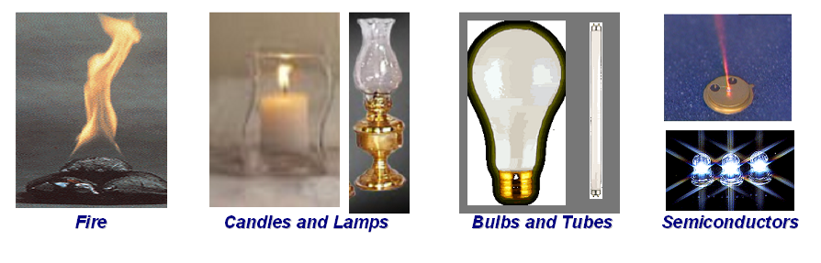
The History of Lighting
THE CASE FOR A NATIONAL RESEARCH PROGRAM ON SEMICONDUCTOR LIGHTING
Roland Haitz and Fred Kish, Hewlett-Packard Company, Palo Alto, CA 94304
Jeff Tsao and Jeff Nelson, Sandia National Laboratories, Albuquerque, NM 87185-0601

Slide 4
Overview
What’s an LED
Lighting Class LEDs?
The Future of Solid State Lighting

Slide 5
Semiconductors for High Brightness LEDs
Ec - conduction band edge
Empty band
Engineered, multilayered crystal structure to efficiently convert current to light. Materials used, layer design and crystal quality determine color and efficiency
E_{c}
Forbidden
E_{g}
E_{v}
Full valance band
What is an LED?
Ev - valence band edge
Semiconductor
Better
10
AlInGaP
Very high brightness LEDs cover the entire visible spectrum using 2 different III-V compound semiconductor material systems
InGaN
1
AlGaAs
Luminous
Intensity
0.1
GaP:N
GaAsP
GaAsP
SiC
Low brightness LEDs
Worse
0.01
400
450
500
550
600
650
700
Wavelength (nm)
Ultra-violet
Blue
Green
Yellow
Orange
Red
Infra-Red

Slide 6
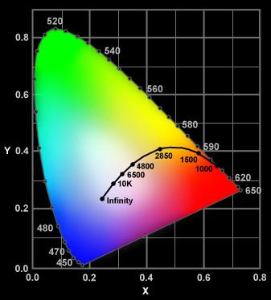
How to Make a White LED
Mixing colors can make white LED
- Red, Green, Blue LEDs used together
- Blue LED plus Yellow Phosphor
- UV LED plus various Phosphors
Phosphor - a material that absorbs light at
one wavelength and emits it at another wavelength
1
0.9
0.8
0.7
0.6
excitation
0.5
relative intensity
0.4
emission
0.3
0.2
0.1
0
350
400
450
500
550
600
wavelength (nm)

Slide 7
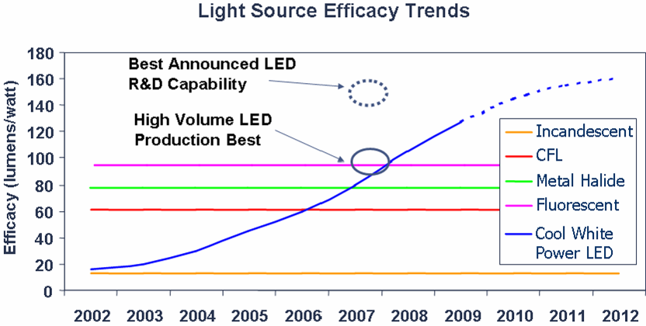
White LED Efficiency Increasing Rapidly
~ 200 Lm/W
Cree, 2010

Slide 8
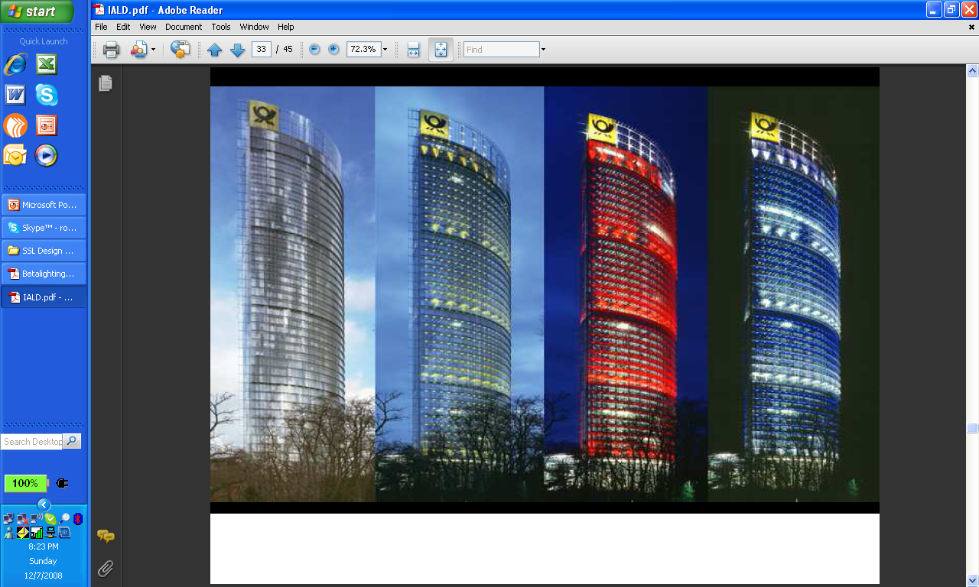
Early LED Use
Architainment (Architecture and Entertainment)

Slide 9
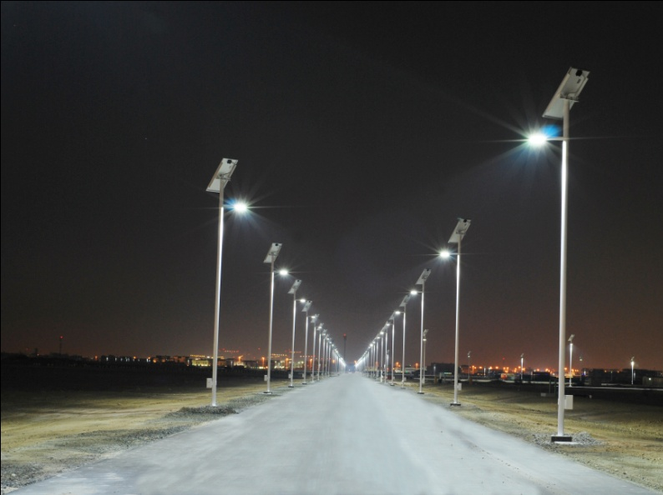
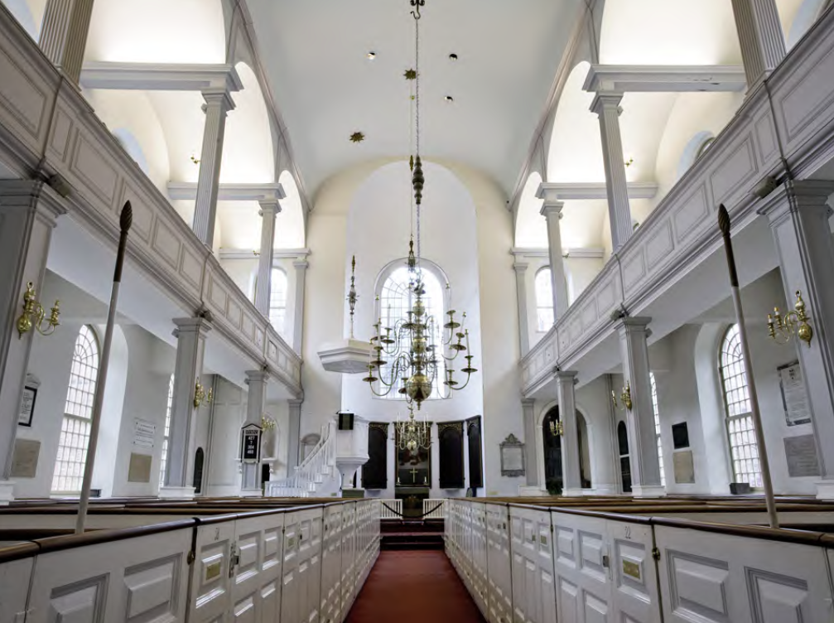
Solid State Lighting – Coming fast
Courtesy of SolarOne
Many street lighting programs
100% SSL buildings are starting to appear (mostly in Asia)
Many hundreds of start-up companies in Solid State Lighting
Generally still not ready for prime time
  Lack of good standards
  Very high prices
  Lots of “junk LED bulbs”
Off Grid LED Street Lighting
Masdar City

Slide 10
The Total Lighting Market is Huge
Total Lighting Equipment Market
Global Lighting Market Size
(in billions) | 2006 | 2011
Lamps (Front-end) | $20.9 | $25.4
Fixtures (Back-end) | $81.1 | $106.6
Total | $102 | $132
North America approximately 29% of the worldwide market
Source: Fredonia Group, Inc.
So there is a tremendous revenue opportunity for LEDs

Slide 11
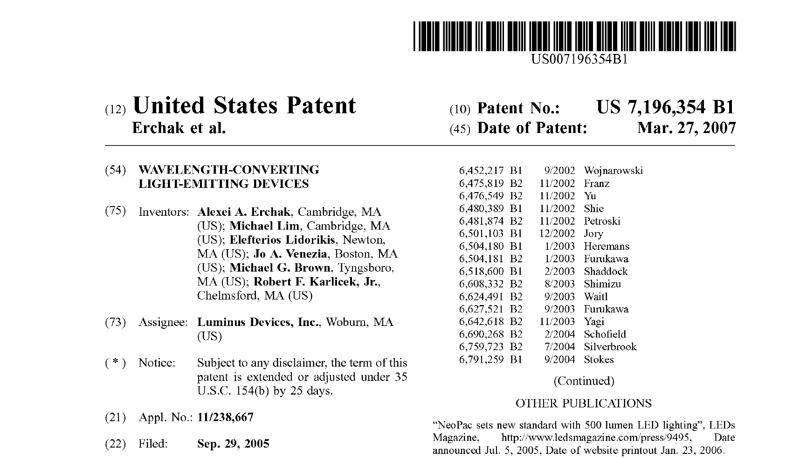
This is where research is published, not peer reviewed literature

Slide 12
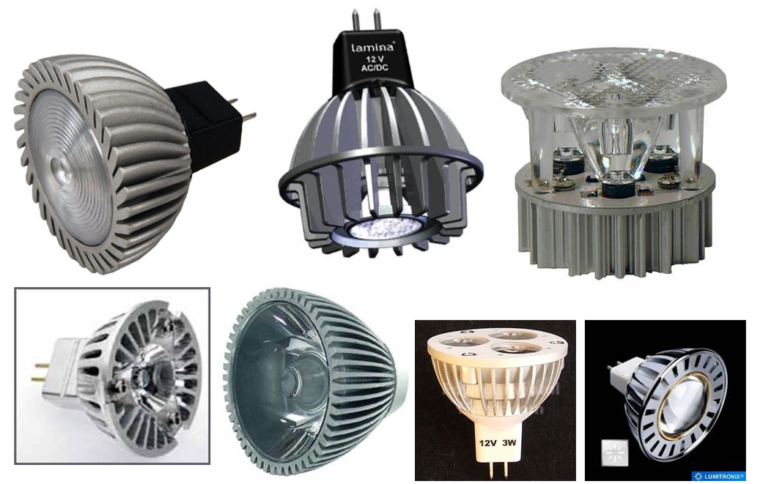
Some Examples of MR-16 LED Products

Slide 13
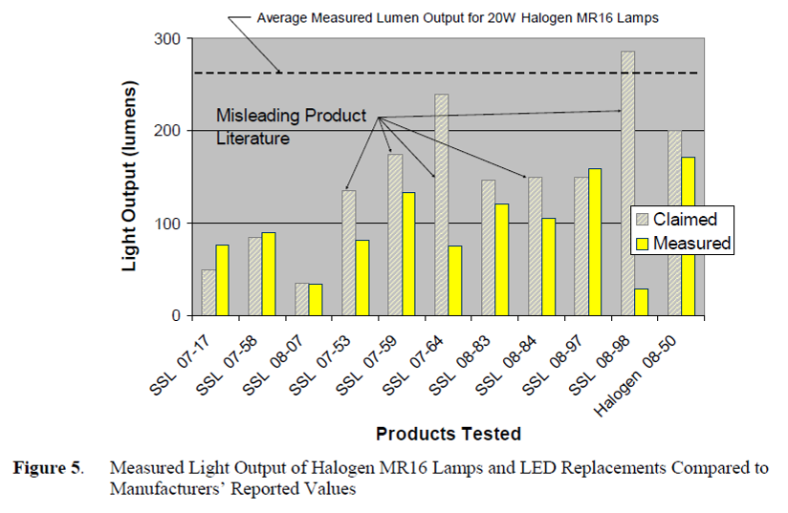
DOE Testing –
Many product claims are misleading

Slide 14
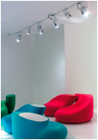
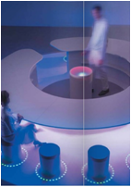
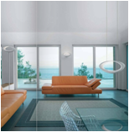
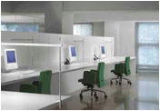
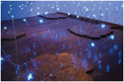
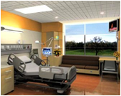
Smart Lighting ERC
A Top Down Vision
Comfort
Health
The Right Light where you want it
Therapeutic Lighting
Energy Efficient Lighting Systems
Lighting Systems interfaced to external
grid & building systems
Adaptive Lighting Systems
Lighting and Data at the same time
Productivity
Information

Slide 15
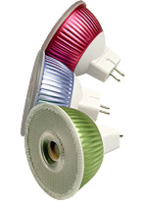
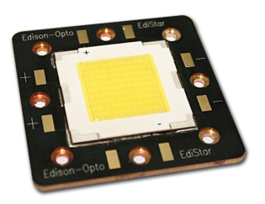
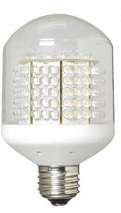
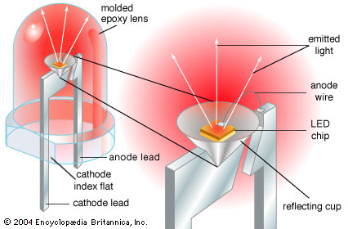
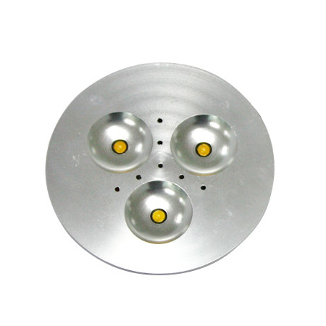
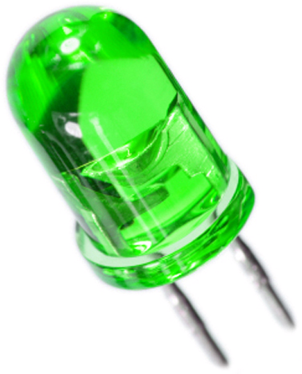
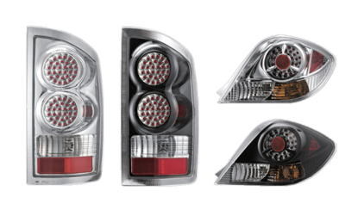
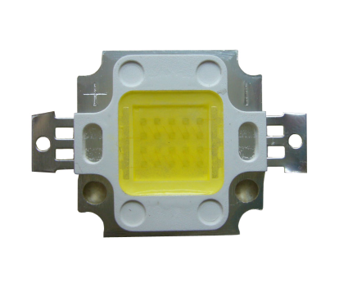
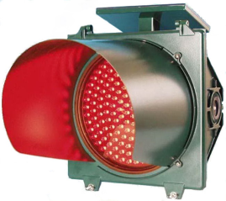
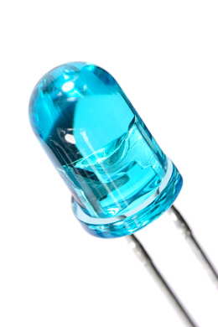
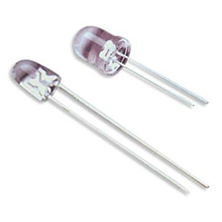
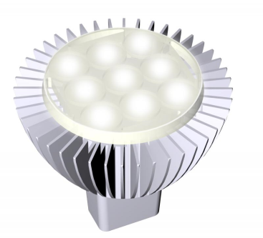
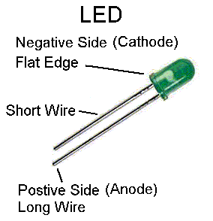
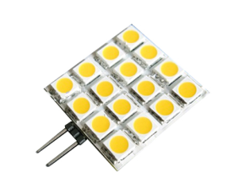
Solid State Lighting

Slide 16
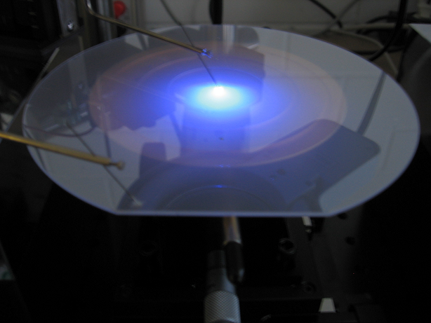
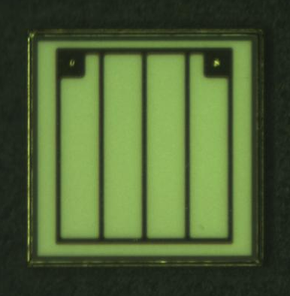
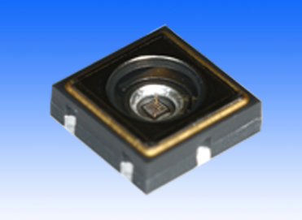
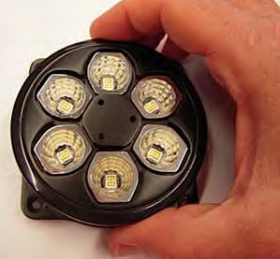
Smart Lighting ERC View of
LED Supply Chain
Materials
and Devices
Materials
and Subsystems
Sources and Sensors
Materials and Subsystem Integration
Smart Spaces
Full System Integration

Slide 17
3 Level Diagram
Systems Integration and Translational Applications
A1.1: ROOMS, BUILDINGS
AND ARCHITECTURE
Productivity
Efficiency
Special Needs: Eldercare
A1.2: INFRASTRUCTURE
AND INFORMATION
Transportation
Communications
Smart Grid Interface
A1.3: HEALTH AND
BIOSENSING
Biohazard Tracking
Bioanalysis Lab
Circadian Rhythm
Enabling Technologies
T2.1: SMART
SPACE TESTBED
T2.2: COMMS
TESTBED
T2.3: BIOSENSOR
TESTBED
REAL WORLD
SYSTEM REQUIREMENTS
TECHNOLOGY SOLUTIONS
OVERCOME BARRIERS
T1: SYSTEMS TECHNOLOGIES:
CONTROL AND COMMUNICATIONS
Fundamental Science: Materials and Device Research
S1: PHOTONIC
SOURCES
S2: PHOTONIC
SENSORS

Slide 18
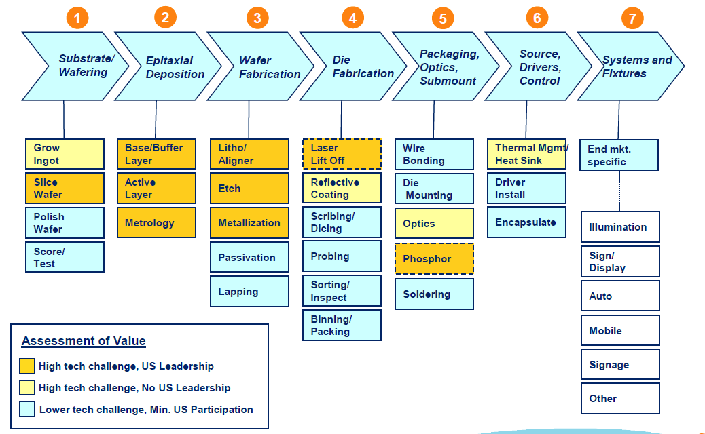
Industrial View of LED Supply Chain
From Applied Materials

Slide 19
Novel Uses of SSL
LEDs and Lighting
Key System Level Aspects
  Chips and Packaging
  Electronics and Optics
  Bulbs and Sockets
Other LED Applications
Smart Lighting

Slide 20
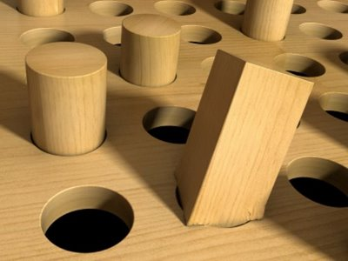
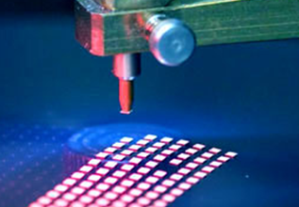
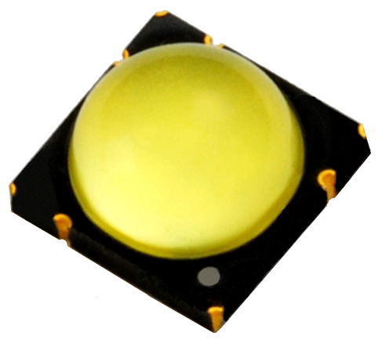
Square Source in a Round Lighting Hole?
DC device in an AC Powered World
Cool light source with thermal management challenges
Great LED Efficacy – High Lm/W
….But low Lumens per part
Cost still way too high ($100 per 1000 Lm)
Can Semiconductor “Thinking” do the job?

Slide 21
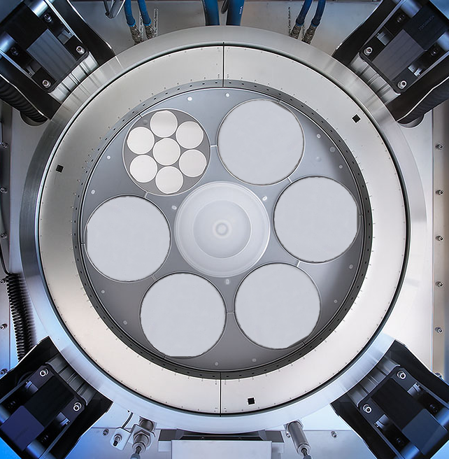
LEDs – the Chips will be Free (almost)
6’’ Wafer = 9 x 2’’ Wafers
Low cost, large diameter substrates
New LED Growth Platforms
(faster, lower cost)
Automated Production
Are radically different approaches to LED chip manufacturing required?
Aixtron 42x2 or 6x6 Production Tool

Slide 22
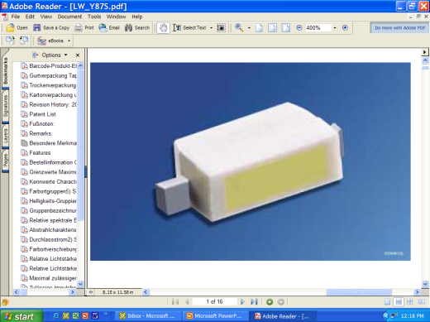
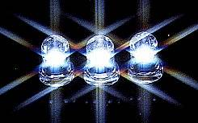
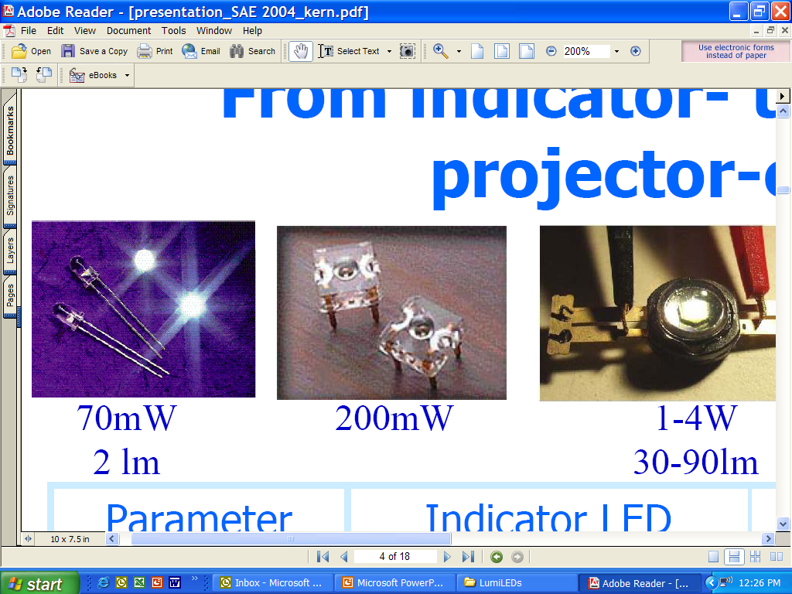
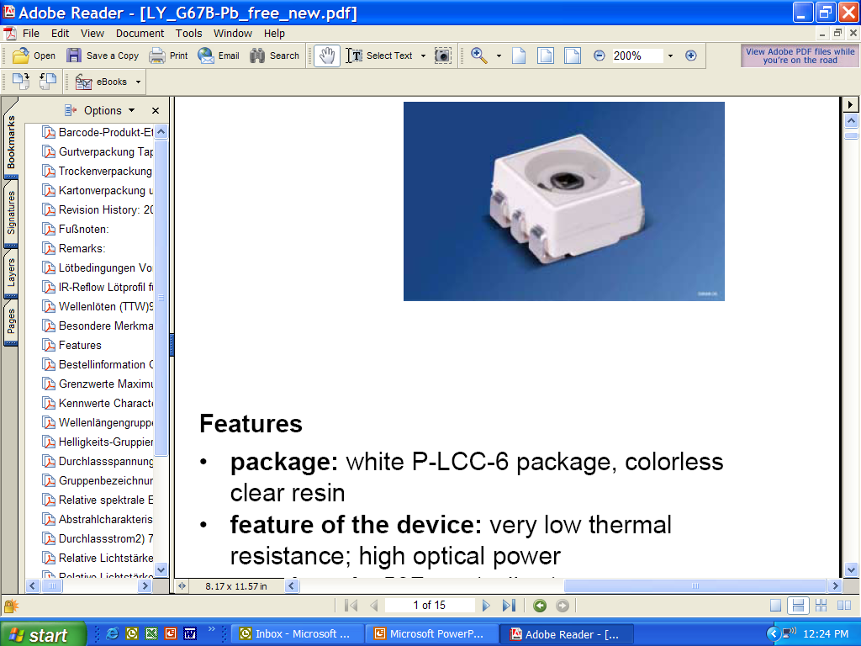
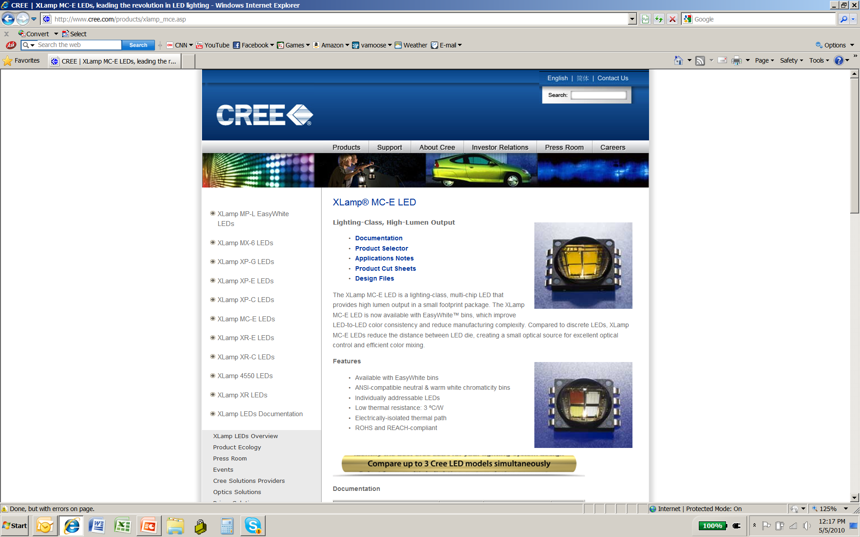

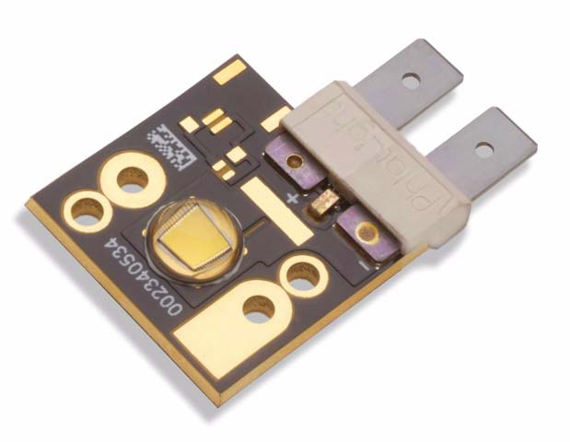
Packaging: Thousands of Styles
Standard Types
(< 1/8 W) – low cost, low light
Medium Power Types
(< 1/2 W)
High Power Types
(1 to 100 W)
No Standard Package – though some more popular than others
Lighting Trends: (1) Lots of small LEDs spread out (diffuse)
(2) Biggest Chip in Smallest Package (spot)

Slide 23
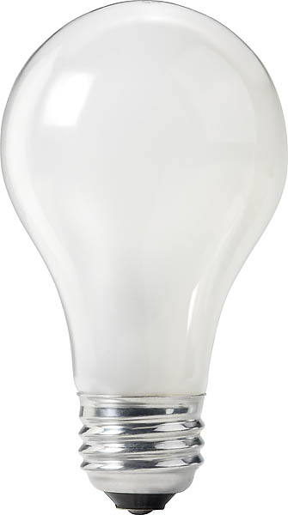
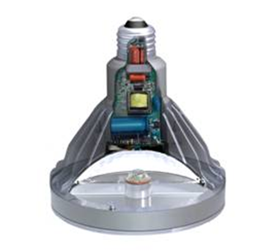
System – Putting it all together
INSIDE
AC LED at 200 Lm/W
Thermal Glass Heat Sink
Remote Phosphor
Non-Yellow Phosphor
Internal Smart
Grid Interface
Etc.
Packaged LED – 100 Lm/W
FUTURE
???????
Thermal Penalty: 0.85
Driver Penalty: 0.85
Optical Penalty: 0.75
Cree LRP-38™ @ 55 Lm/W
(Efficiency of system parts are approximate)
Will we still need a socket?

Slide 24
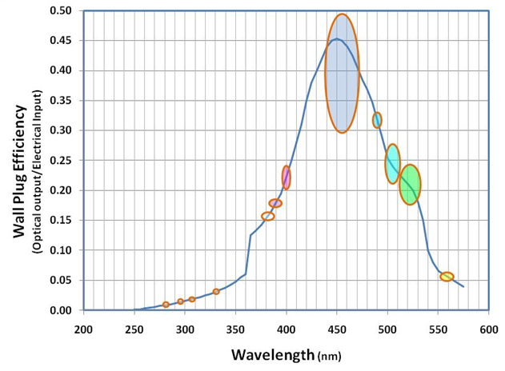
Efficiency versus Wavelength
Nitride Based LEDs
Industrial
Lighting
Recent Data
What About Other Energy Efficiency Applications

Slide 25
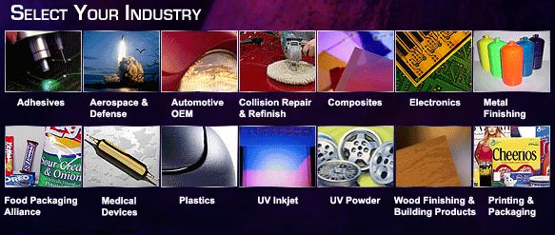
UV Curing
Cuts drying energy consumption by ~70%
No solvent emission – “dries” by polymerization
Only ~20% of manufacturing processes that
could be UV cured are using UV curing today

Slide 26
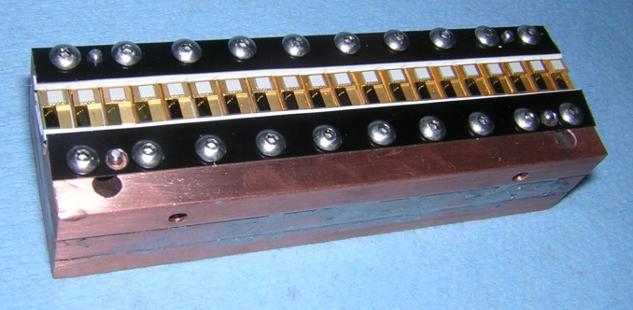
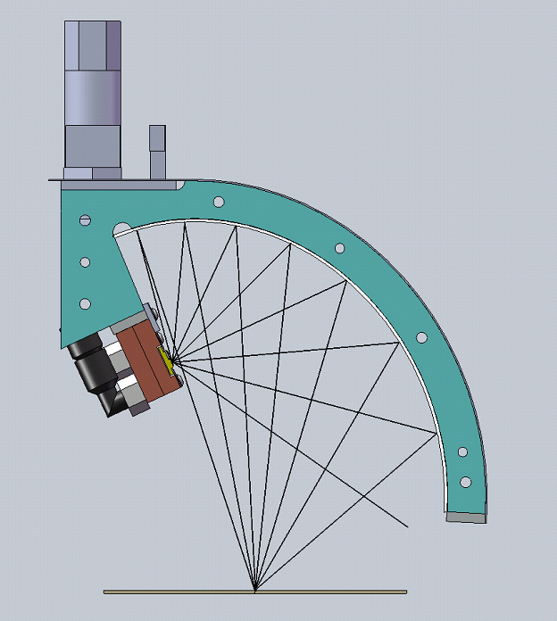


Replace Hg Bulbs with UV LEDs
Hg Arc Lamp
(300 W/in)
65% of energy in IR
UV LED Array
(150 W/in)
No IR
Hg Lamps – about $700M/year in
Replacement Lamps
Green House Gas Emissions Reductions for a single product
(3 production lines @ 24x5)

Slide 27


Today’s Lighting
Do we really need sockets?
(when LEDs outlast buildings)
Semiconductor paradigm the right model?
(Can we get the costs we need?)
Lighting Design – What we want or a cover up for poor light sources

Slide 28

Look Up
Right Above the Smart Lighting ERC Door
Lamp Facts
Chip Supplier | Nichia
Packager | Citizen
LED Count | 108
Watts | 7.8
Lumens | 550
CCT | 3000K
Cost | $90
Compared to a 75W PAR 30 Incandescent Lamp:
Electrical savings offsets higher cost in one to two years, depending on usage (on-time) – for 24 hr. operation at $0.12/kWhr, payback is < 1 year
Lifetime of over 50,000 hours, or about 20x better than an incandescent bulb
The Smart Lighting ERC would like to thank Nexxus for providing the lamp

Slide 29
Summer Undergrad Students
Irene Benny- RPI
Rachel Romines – Rose-Hulman
Dennis Deensie – Morgan State
Daniele Manikeu – Morgan State
Adrianna Anderson – St. Rose
Tiffany Knapp – St. Rose

Slide 30

LIGHT

Slide 31
LIGHT – How Do We Use It?
Illumination – Lighting in our homes and work, for our cars, etc.
Imaging – Microscopes, telescopes, photography, etc
Displays – Television and Computer Monitors (CRT, Plasma, LCD, etc.)
Signaling – Traffic lights (cars, trucks, trains, boats, etc.), laser pointer, etc.
Information – Optical fibers, read-write for storage (CD, DVD, Blu-Ray, etc), barcode, etc.
Cutting, etching, etc.

Slide 32



Characteristics of Light
Spectrum (Color)
Polarization
Time Variation (Blinking)
Direction

Slide 33


Making Light Smart
Light Source
  LED
Power for Light Source
  Battery
  (DC Voltage)
Control
  Computer
  (Processor)

Slide 34



Smart Lighting
Smart Lighting System

Slide 35


Similar to Robotics

Slide 36

Making Light Through Electronics
LED (Light emitting diode)
Resistor
Wires
Battery
We have made a solid state light
Such a light could be used to send flashing signals
This is what the stop and go lights (red, yellow, green) are made from these days
http://www.robotroom.com

Slide 37

At Home Without the Protoboard
Note the longer leg
Connect to the shorter leg
Twist the wires together
Then Connect the Battery Using the Black and Red Wires

Slide 38



Many Other Projects are Possible
http://www.robotroom.com

Slide 39
Flashing Lights Sending Information
Remote Control – See it on a camera
Music Traveling on Light
Hearing a Remote
Sound Activated Switch
Polarization & Displays

Slide 40







Displays
MirasolMEMS
CRT
Plasma
TI LED DLP MEMS
http://www.dlp.com/tech/what.aspx
LCD

Slide 41


We Can Also Control Light Electrically
Crystal
Liquid Crystal

Slide 42

LCD
LCD

Slide 43

RGB

Slide 44

LCD

Slide 45

The Future?
Iridium – An Entertaining Failure or
Now on the Road to Success?
What are some of the limitations of present mobile phone systems?
One of the primary problems is that service tends to be limited to higher population areas.
If you are a Verizon customer (in spite of the annoying adds), you have the coverage shown in this map.

Slide 46
Iridium
1987: Two Motorola engineers envision a constellation of low orbiting satellites.
1990: The Iridium System is announced.
1995: FCC License granted
1998: Constellation of 66 satellites successfully launched.
1999: Chapter 11
2002: Licenses, etc. assigned to New Iridium
Note: Financing was several billion dollars

Slide 47


Iridium Flares – Fun With Satellites
The Iridium satellites are relatively small telecommunications satellites in a low Earth orbit.
Each satellite has three main mission antennas (MMAs), which are flat, highly reflective surfaces, that can reflect the Sun's rays to an observer on the ground when the geometry is correct.

Slide 48
Iridium Flares – Fun With Satellites
The satellite's attitude is controlled so that the long axis remains vertical, with one MMA always pointing forwards. Given this knowledge of the attitude, together with the orbital position of the satellite and the Sun and observer's location, it is possible to calculate the angle between the direction to the observer from the satellite and the line of a perfect reflection of the Sun. This is the so-called "mirror angle" and determines the magnitude of the flare.

Slide 49


Iridium Flares
Heavens Above is an extensive website with information on tracking objects in space, notably including Iridium Satellites.

Slide 50
Iridium Flares
In the main Heavens Above webpage, select your location either exactly by longitude and latitude or from their extensive database.
Choose United States, then Sycaway (where I live) Latitude: 42.742, Longitude:73.653, Elevation: 121 m
Select Iridium Flares for the Next 7 Days.

Slide 51


Slide 52

Iridium Flares

Slide 53


Iridium Flares

Slide 54

Iridium Flares
What will you see?
Look at http://homepage.mac.com/kevision/video/iMovieTheater25.html and http://www.youtube.com/watch?v=1PFUP5LPyuA

Slide 55

Remote Controls
Infrared Light
Cannot be seen by humans
Can be seen by digital camera
Remote control sends light flashes to TV or any other device it is to control

Slide 56
Music Traveling on Light Flashes
We can hear the light flashes from the remote
Remote
Transmitter
Receiver
Speaker
Music Source
Sound

Slide 57


Butterfly and Bee Vision

Slide 58


The Clapper

Slide 59
The Clapper
Sound
Microphone
Amplifier
Counts to 2
Conditioner
Amplifier
Relay
This is a good example of a system that makes a decision based on some kind of input

Slide 60




Questions?

Slide 61


More to Come

