Slide 1
Nanotechnology in Smart Lighting
Kenneth A. Connor
Education Director
Smart Lighting ERC

Slide 2
Overview
Introduction
Who am I & Why am I an Engineer?
A Local Boy Does Good & How My Career Built on His Success
Systems
Smart Lighting ERC
Light & Light-Based Activities
Nano in Smart Lighting
Additional thoughts

Slide 3
Who Am I?
My name is Ken Connor
I am a Professor of Electrical, Computer, and Systems Engineering and Information Technology at Rensselaer Polytechnic Institute in Troy, NY

Slide 4
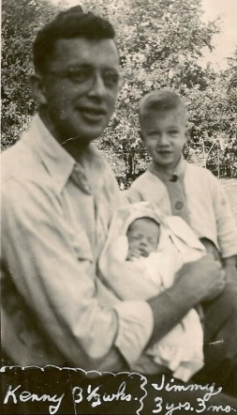
Who Am I?
I was born in Madison, WI

Slide 5
Who Am I?
I have two brothers

Slide 6
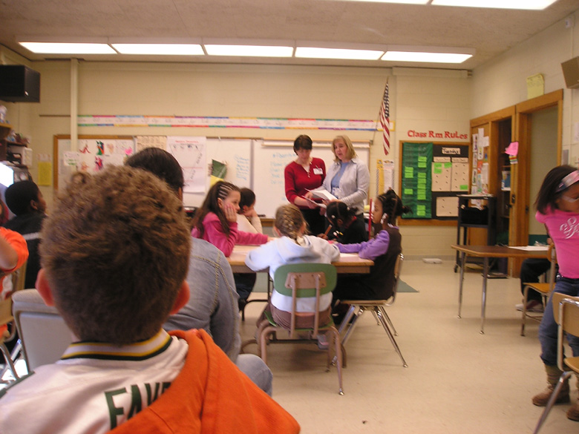
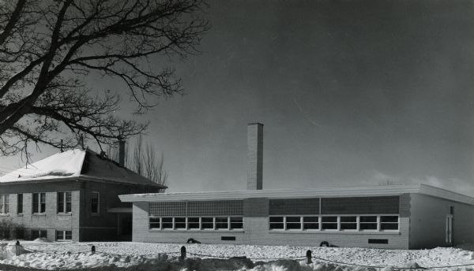
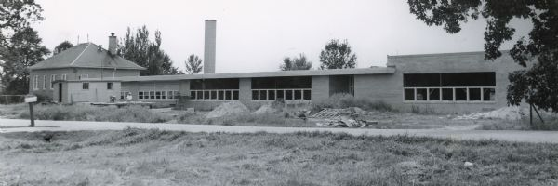
Who Am I?
I attended Mendota School from 1952 – 1958

Slide 7
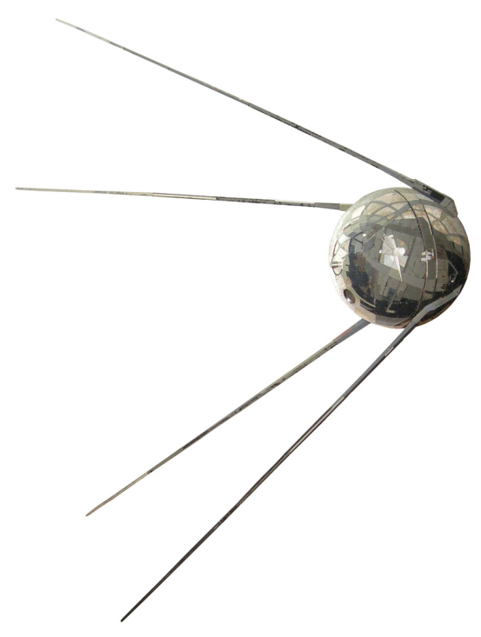
Why am I an Engineer?
October 1957 – Sputnik 1 (Спутник-1)
6th Grade Class – 4 students selected for advanced studies
7th & 8th Grade Math & Science Combined
Began HS Math & Science in 8th Grade
Diameter = 58.5 cm
Inside
Sounds
http://www.nytimes.com/interactive/2007/09/24/science/space/20070924_SPUTNIK_GRAPHIC.html#tab1
http://www.mentallandscape.com/Sputnik1_WashingtonDC.mp3

Slide 8
Me
29 March 1958

Slide 9
?

Slide 11
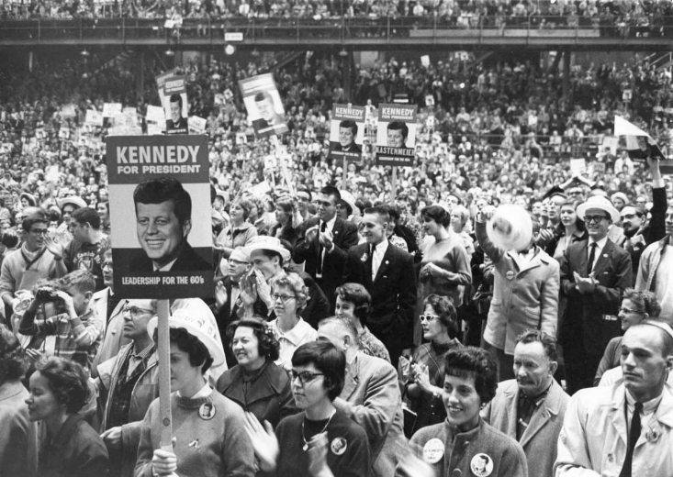
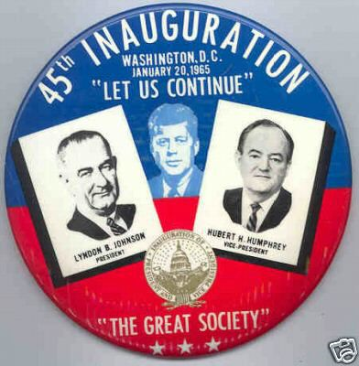
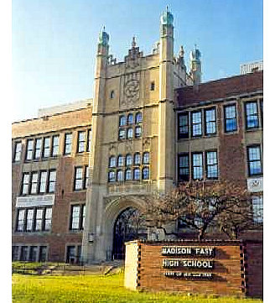
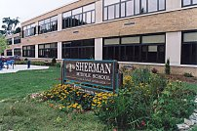
Who Am I?
I attended Sherman Junior High School from 1958 – 1961
I attended East High School from 1961 - 1964

Slide 12
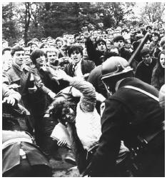
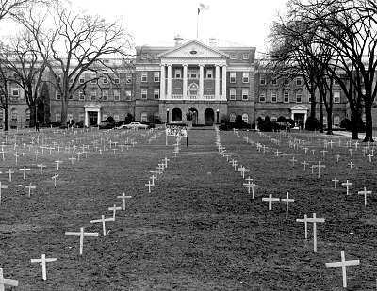
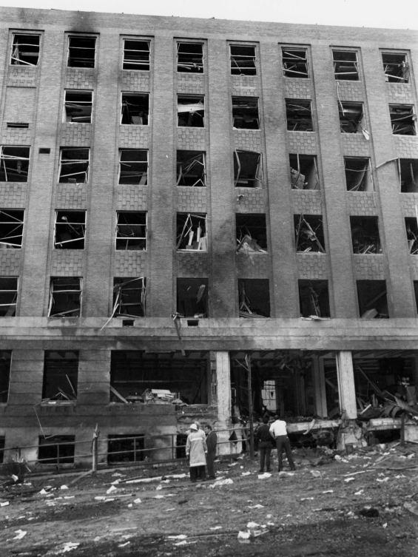
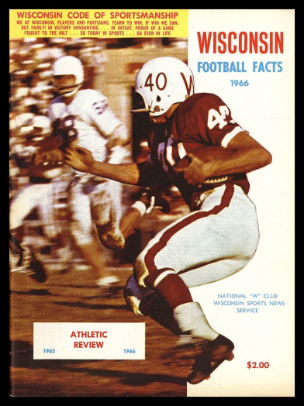
Who Am I?
I attended the University of Wisconsin from 1964 – 1970 receiving two degrees in Electrical Engineering
Students Kidnap
Dow Recruiter
Physics Building Bombed
UW Football 11-45-3 during these years

Slide 13
Why am I an Engineer?
Why did I go to engineering school when none of the other three accelerated students from my elementary school did?
My theory – my dad was the ‘go to’ person for our extended family … if anyone had a problem they could not solve, they asked him to help. This made his sons problem solvers … it does not matter what the problem was, we do our best to find a solution.

Slide 14
Who Am I?
I attended the Polytechnic Institute of Brooklyn from 1970 – 1974 receiving a PhD in Electrophysics
I have been a professor of Electrical Engineering at Rensselaer Polytechnic Institute in Troy, NY since 1974.
www.rpi.edu/~connor

Slide 15
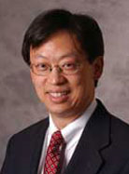
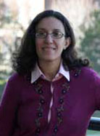
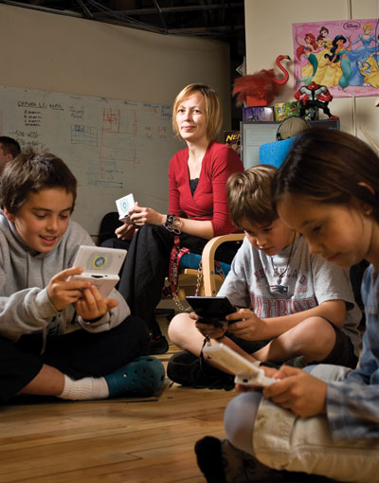
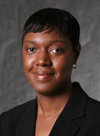
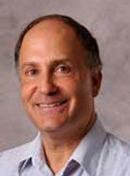
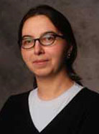
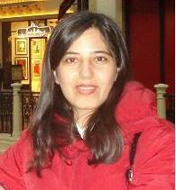
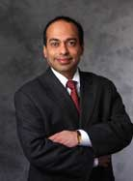
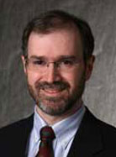
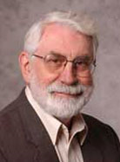
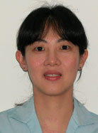
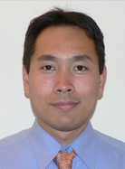
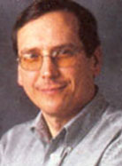
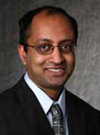
I Get to Work with Really Great People
Professors in My Department
Tobi Saulnier – Founder of 1st Playable

Slide 16
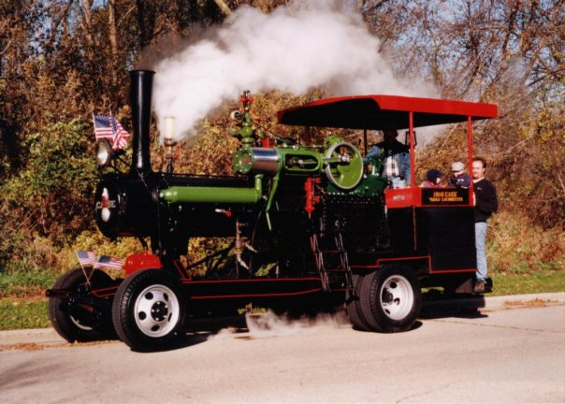
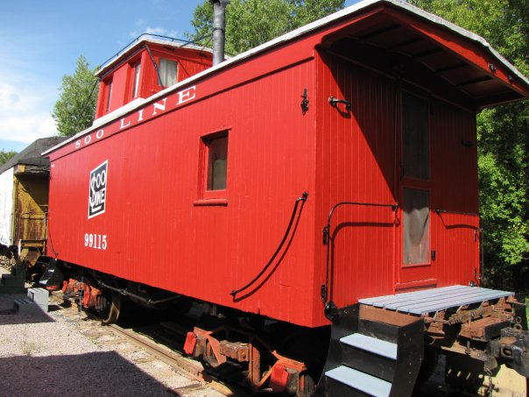
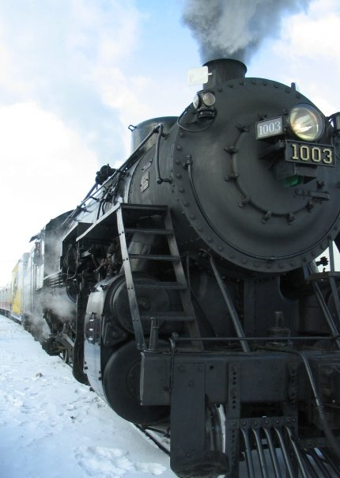
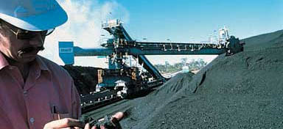
My Brothers Today
Metso Minerals Industries, Inc.
Mining Services North America

Slide 17
Why Be an Engineer?
Engineers make a world of difference
Engineers are creative problem-solvers
Engineers help shape the future
Engineering is essential to our health, happiness and safety
From the NAE

Slide 18
NAE Study
It is a good idea to read at least the executive summary of this document, which is free online, but cannot be fully downloaded for free.
http://nae.edu/nae/naepcms.nsf/weblinks/MKEZ-7FWNXE?OpenDocument

Slide 19
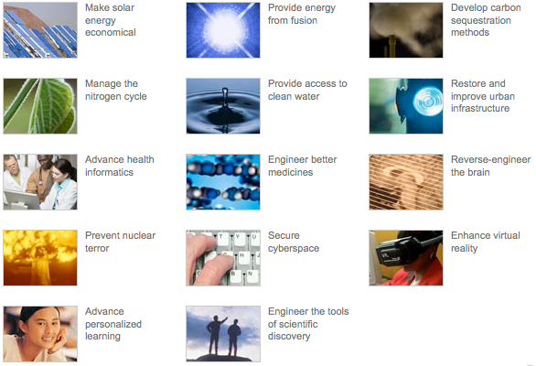
Grand Challenges

Slide 20
Grand Challenges
Download the report
Watch the PR video
Select your favorite challenge
http://www.engineeringchallenges.org/cms/challenges.aspx

Slide 21
Thinking Like an Engineer
There are many resources available from professional societies, etc.
From the ASME, for example.
ASEE has extensive K-12 support
Links I have collected
http://hibp.ecse.rpi.edu/~connor/EOD/
Historical Connection – Theodore Judah
http://cprr.org/Museum/Judah_Report_1863.html
One the most interesting people to have attended RPI

Slide 22
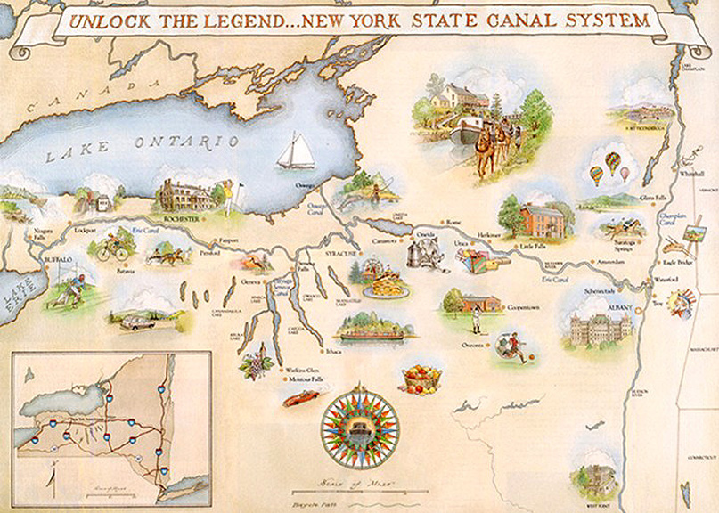
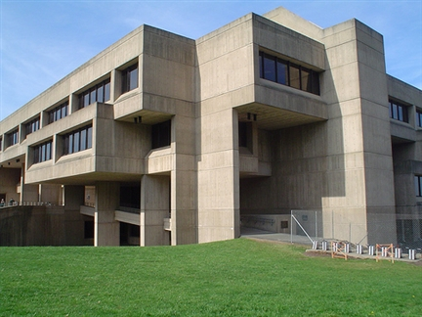
Why Are We Here?

Slide 23
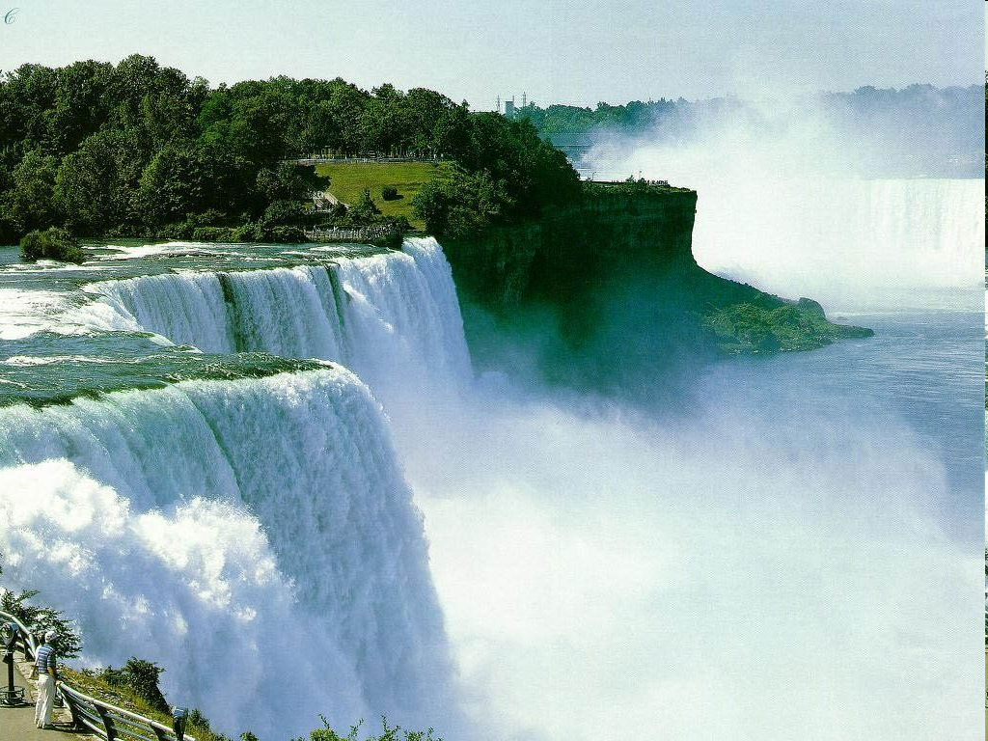
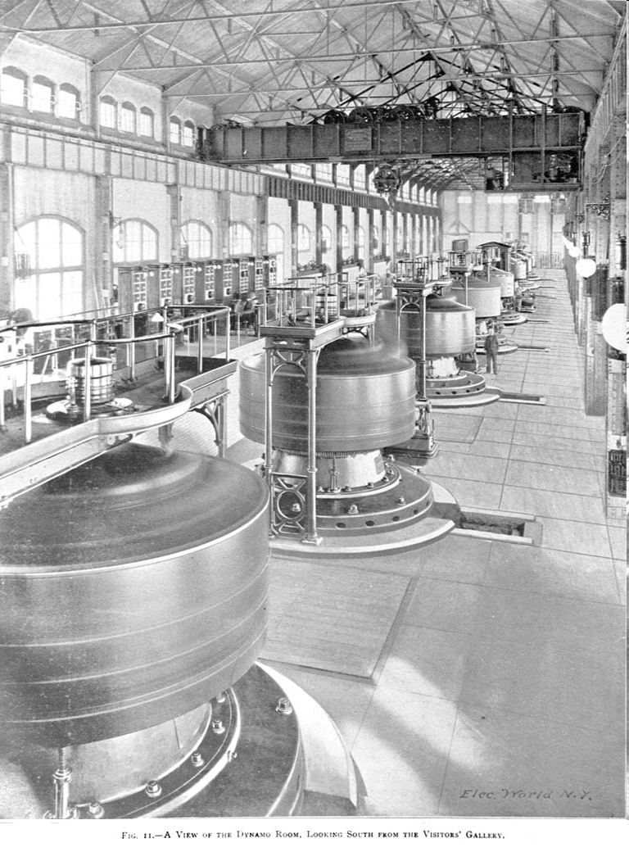
Also

Slide 24
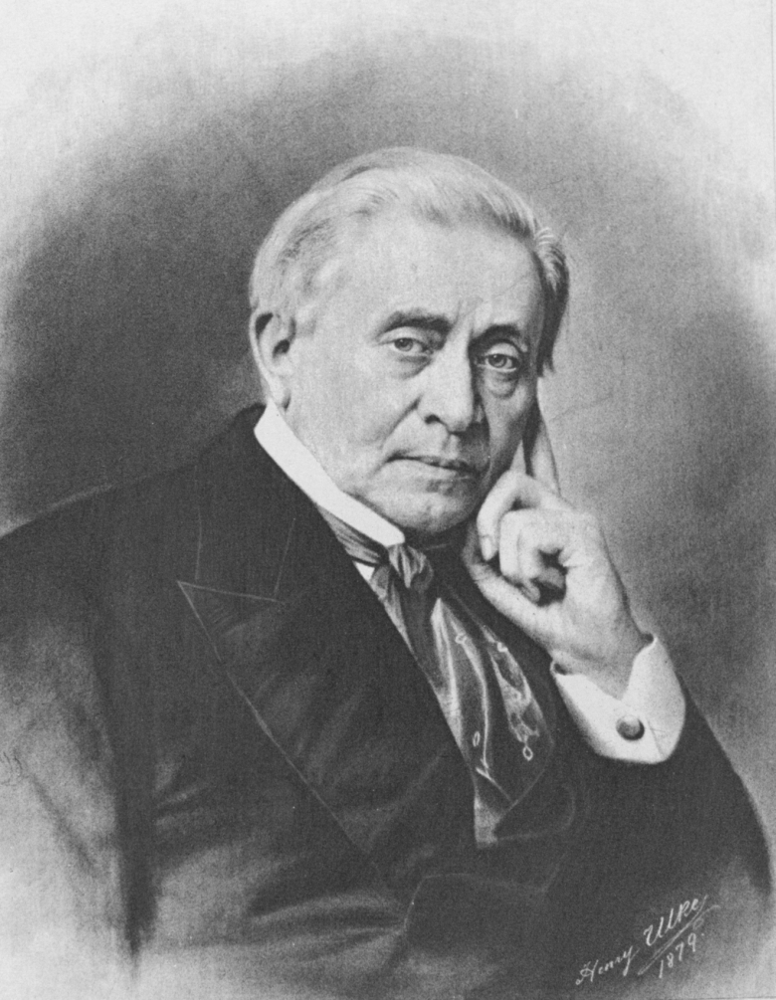
Joseph Henry
http://maps.google.com look up Albany, NY

Slide 25
Joseph Henry
Born in Albany, December 17, 1797
Grew up in Galway with his grandmother after his father died
1819 Entered Albany Academy
1826 Professor at Albany Academy
1832 Professor at Princeton
1846 First Secretary of the Smithsonian
1863 Co-founder and 2nd President of NAS
Died, May 13, 1878

Slide 26
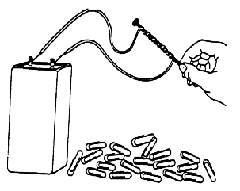
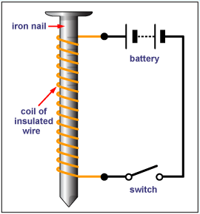
Joseph Henry
What is one of the keys to making a powerful electromagnet?
Insulation
Electromagnet

Slide 27
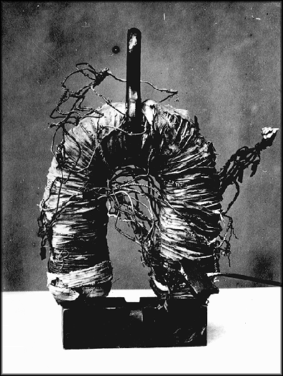
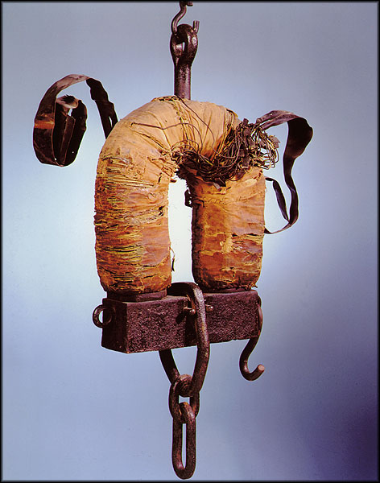
Joseph Henry
His key practical contribution to the electromagnet – how did he do it?

Slide 28
Joseph Henry
In 1820, Danish physicist Hans Christian Oersted had discovered that the flow of an electric current produced a magnetic field around the wire. This amazed scientists and many, including Henry and Faraday, began to experiment with magnetism. In 1829 Henry learned that William Sturgeon had built an electromagnet that could lift nine pounds. This was quite remarkable, but Henry believed he could create a magnet that was much stronger. The secret was to wrap more wire around the iron core, overlapping the levels. However, wire in that era was not insulated, so wrapping one level over another caused a short circuit. Henry got around the problem by the laborious process of insulating the copper wire by hand, using strips of his wife's silk petticoats.

Slide 29
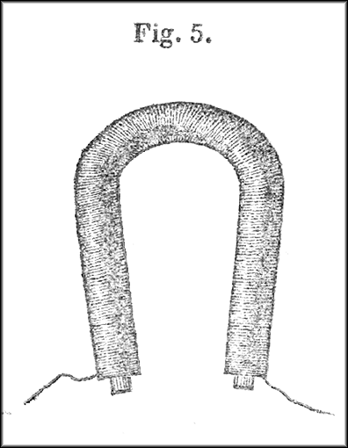
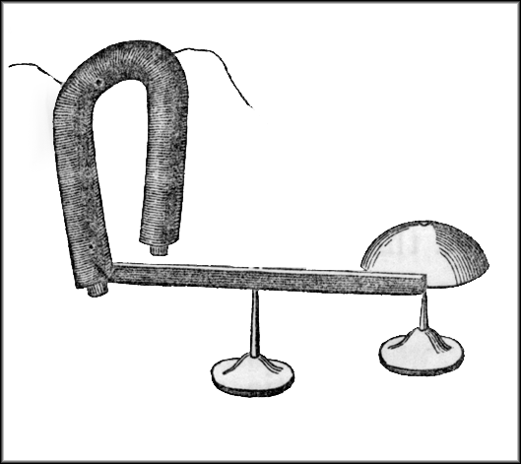
Joseph Henry
He recognized that the magnet could be the key part of a long distance signaling device – this became the telegraph

Slide 30
Joseph Henry
Simple idea – properly insulate the wires so that many turns could be added to a magnet – which he called intensity magnets
Saw the potential of the more powerful device as the beginning of long distance communication
Also demonstrated that a motor could be made, although his did not turn
His work made motors & generators and essentially all electric power equipment possible

Slide 31
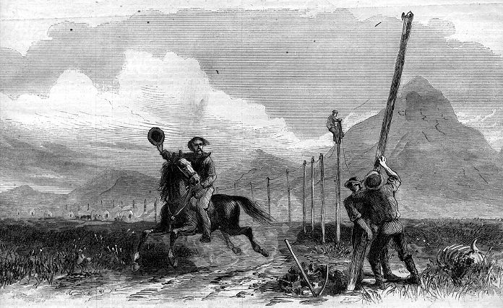
Telegraph
Send messages to people over very long distances
What can we do with a strong magnet?

Slide 32
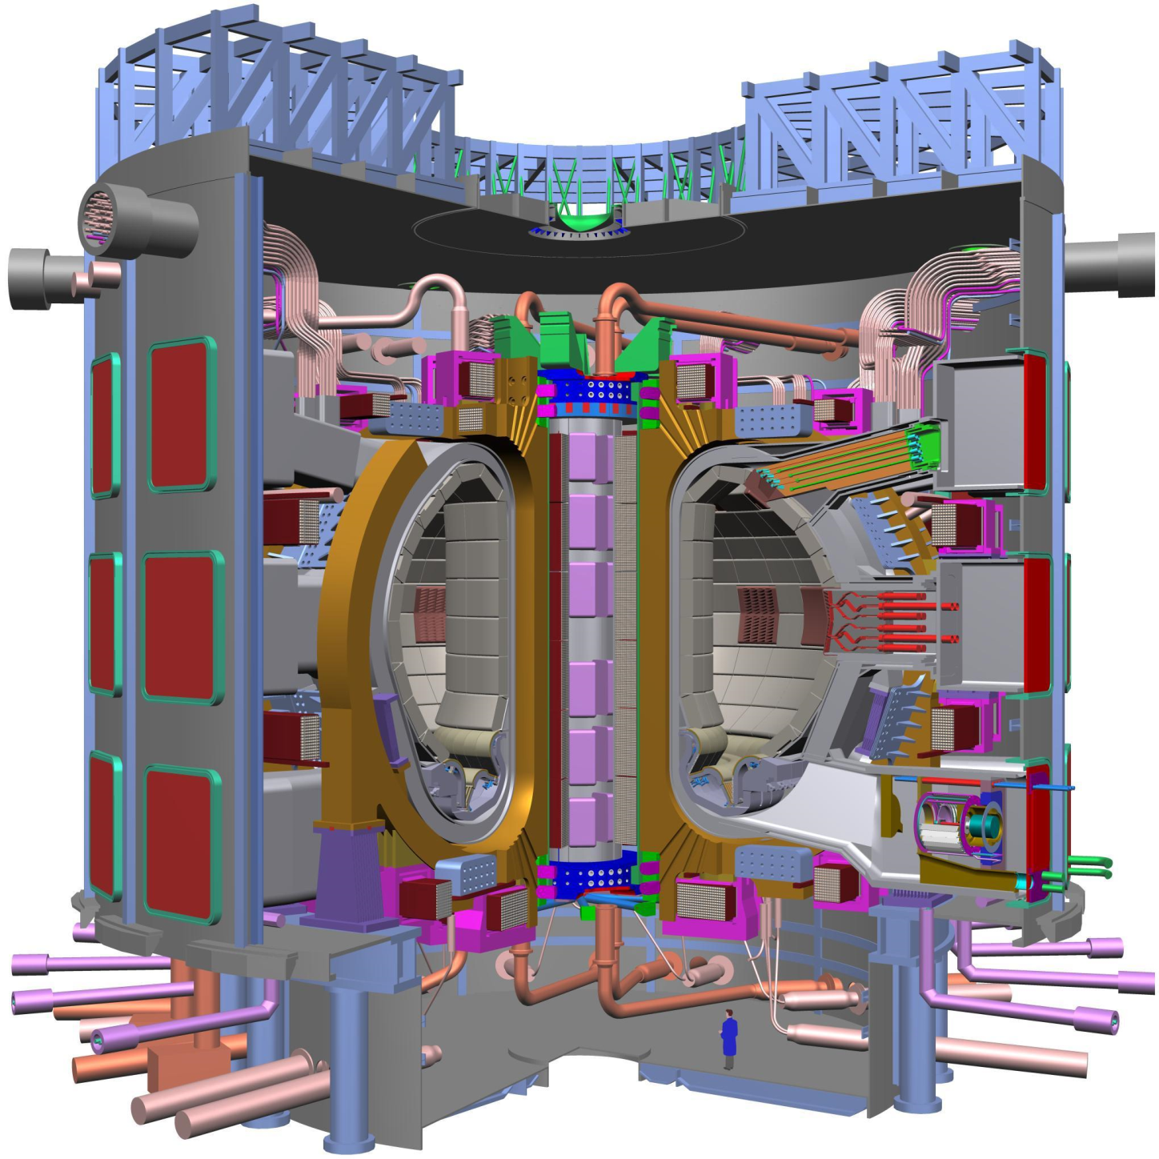
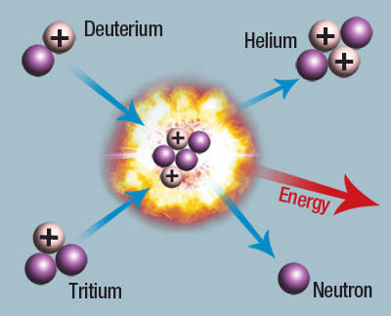
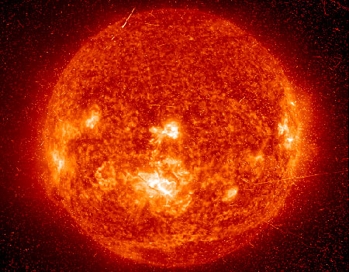
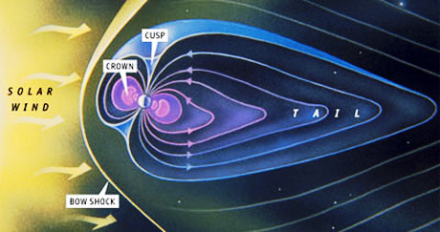
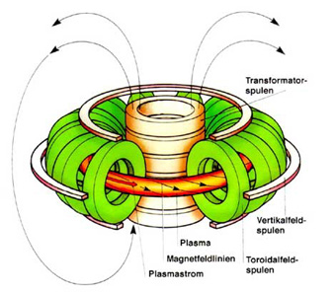
Nuclear Fusion Research
ITER
I have worked to help obtain controlled nuclear fusion since 1968

Slide 33
Thinking Like an Engineer: Systems
What is a system?
Can we think of any examples?
Concept: A system is something made from a collection of simpler things – usually called components, parts, or subsystems. Each part has a function and the collection of parts have relations among them that let the assemblage accomplish some larger function.
Notes:
How about something with the word system in its name?

Slide 34
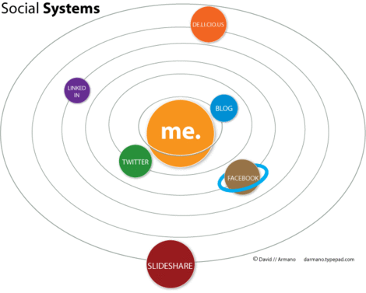
Systems Examples

Slide 35
Systems Concepts
Concept: There is no answer to the question “is A better than B” unless you know the larger context, the system, in which A or B will be used and how A or B will interact with the other components of that system!
Example: Using hydrogen as a transportation fuel. The usual rationale is that when hydrogen burns the result is pure water, so no pollution. That’s true, but it’s not the whole story. Hydrogen isn’t something that you can pump out of the ground; it has to be made. A hydrogen-powered vehicle, then, is part of a larger system that includes at least the process of making hydrogen, transporting it to where it will be used, storing it on board the vehicle, and perhaps more. Whether using hydrogen as a transportation fuel is a good idea depends on whether all of these things taken together are a good idea.
Example: Is an electric car better than a gasoline car?
Lessons from Bill Wulf, former President of NAE

Slide 36
Smart Lighting ERC
A Top Down Vision
Comfort
Health
The Right Light where you want it
Therapeutic Lighting
Energy Efficient Lighting Systems
Lighting Systems interfaced to external
grid & building systems
Adaptive Lighting Systems
Lighting and Data at the same time
Productivity
Information

Slide 37
Solid State Lighting

Slide 38
Making Light Smart
Light Source
LED
Power for Light Source
Battery (DC Voltage)
Control
Computer (Processor)

Slide 39
What Are We Up To?
The vision of the Smart Lighting: The Right Light Where and When You Need it. Accomplished by an integration of advanced light sources, sensors, and adaptive control.
Efficient LED (Light Emitting Diode) bulbs are only the first wave of solid-state lighting. The Smart Lighting Engineering Research Center (ERC) will create the second wave of solid state lighting, consisting of lighting systems with adaptive functionality, able to measure and control the many different and largely unused properties of light. Smart Lighting will provide additional significant systems-level energy savings and add a whole new range of capabilities to displays, communications and biosensing.

Slide 40
What Are We Up To?
The transformative technologies being developed by the ERC will help the U.S. recover a position of prominence in the development of Smart Lighting, with tremendous implications for lighting, medical, energy, and information technology sectors.
The ERC will educate a new generation of students with the interdisciplinary skills, global technology exposure and business sense to bring new ERC technologies to market.
ERC is forging deep working relationships with industry to help define the future of Smart Lighting. Industry is engaged in our translational technology activities and is driving the innovation, educational outreach, and diversity efforts that are critical parts of the ERC mission.

Slide 41
LIGHT

Slide 42
LIGHT – How Do We Use It?
Illumination – Lighting in our homes and work, for our cars, etc.
Imaging – Microscopes, telescopes, photography, etc
Displays – Television and Computer Monitors (CRT, Plasma, LCD, etc.)
Signaling – Traffic lights (cars, trucks, trains, boats, etc.), laser pointer, etc.
Information – Optical fibers, read-write for storage (CD, DVD, Blu-Ray, etc), barcode, etc.
Cutting, etching, etc.

Slide 43
Characteristics of Light
Spectrum (Color)
Polarization
Time Variation (Blinking)
Direction

Slide 44
Smart Lighting
Smart Lighting System

Slide 45
Similar to Robotics

Slide 46
Making Light Through Electronics
LED (Light emitting diode)
Resistor
Wires
Battery
We have made a solid state light
Such a light could be used to send flashing signals
This is what the stop and go lights (red, yellow, green) are made from these days
http://www.robotroom.com

Slide 47
At Home Without the Protoboard
Note the longer leg
Connect to the shorter leg
Twist the wires together
Then Connect the Battery Using the Black and Red Wires

Slide 48
Flashing Lights Sending Information
Remote Control – See it on a camera
Music Traveling on Light
Hearing a Remote
Sound Activated Switch
Polarization & Displays
Others?

Slide 49
Displays
MirasolMEMS
CRT
Plasma
TI LED DLP MEMS
http://www.dlp.com/tech/what.aspx
LCD

Slide 50
LCD
LCD

Slide 51
Nano in Smart Lighting
How can we use nanotechnology to improve or realize smart lighting?
Any ideas?
Think of optical properties of materials
Think of waves more generally
Are there other properties that matter?
What about sensors?

Slide 52
Photonic Crystal
VHF Frequency – 100 MHz
UHF Frequncy – 500 MHz
Remember TV Antennas?
Antenna elements are typically one half wavelength long

Slide 53
Photonic Crystal
Dimensions of light waves are smaller.

Slide 54
Nano Structures
Plasmonic NanoAntennas
Plasmonic Nanoholes
Complex Nanocavities
Boston University – Hatice Altug
Photonic Crystal
Catholic University of Leuven

Slide 55
Index of Refraction
Can someone describe your Wednesday experience on Light Scattering: Effect of Refractive Index ?
What was the most recent big news on the GLOBALFOUNDRIES (AMD) plant being built nearby?
Wafers will be 18” (450mm)
We build electronic and photonic devices on substrates.
What is different about the substrates we use for LEDs and other electronic devices?
They must be transparent.

Slide 56
Index of Refraction
N
P
AlInGaP
Si, glass or metal
substrate
LUMILEDS

Slide 57
Index of Refraction
Snell’s Law:
We get reflection unless the difference in index is very small.

Slide 58
Index of Refraction
Low Index Materials
High Index Materials
 | Air | Water | Sapphire
Index | 1.00 | 1.33 | 1.77
We need to be able to make materials with indices close to air and sapphire – can be done with nanotechnology
 | Diamond | Gallium Arsenide | Silicon
Index | 2.42 | 3.93 | 4.01

Slide 59
Example LED Companies
Philips Lumileds
http://www.philipslumileds.com/
http://www.youtube.com/watch?v=048ApwN0NyU (1:25)
CREE
http://www.cree.com/
http://www.youtube.com/watch?v=eVWxYyxc-9g&feature=PlayList&p=061D62548EE60704&playnext=1&index=21
Nichia
http://www.nichia.com
Osram
http://www.osram.com/osram_com/LED/index.html

Slide 60
Making LEDs with Nanorods
Coaxial Nanowire LEDs

Slide 61
Year 3 Coaxial Nanowire/Nanowall LEDs
Year 3: Individually addressable LED/sensor arrays for wavelength selectivity and VLC systems
Year 2: First demonstration of Coaxial NW LED array
Year 3: Full InGaN active region growth for multiple wavelengths

Slide 62
How to Make a White LED
Mixing colors can make white LED - Red, Green, Blue LEDs used together - Blue LED plus Yellow Phosphor - UV LED plus various Phosphors
Phosphor - a material that absorbs light at one wavelength and emits it at another wavelength
1
0.9
0.8
0.7
0.6
excitation
0.5
relative intensity
0.4
emission
0.3
0.2
0.1
0
350
400
450
500
550
600
wavelength (nm)

Slide 63
Efficiency versus Wavelength
Nitride Based LEDs
Industrial
Lighting
Recent Data
What About Other Energy Efficiency Applications

Slide 64
Challenges with Phosphors?
They already work very well for standard lighting … the large peak on the previous slide is for the blue LEDs used to make white phosphor LEDs.
They scatter light
They are slow
Others?

Slide 65
Nano in Smart Lighting
High and low index of refraction
Nano-column and Nano-finger LEDs fabricated – high light extraction and exploration of strain field effects on droop reduction
Polarized LED (green on m-plane GaN) and models of photonic crystal designs for RGB polarized LED manufacturing
Nano-wire UV LED growth with very low dislocation density – droop and green gap implications
Non-scattering graded composition phosphor for high performance white LEDs

Slide 66
Optical vs. RF
Lets look at the RF spectrum in a narrow but well used band.
Consider the audio spectrum first
Wi-Spy
Fun last demo

Slide 67
Nano Outreach at BU
Boston Upward Bound Math and Science Program (BUBMS): Nanophotonics & Nanofabrication (Altug)
Optical: Provide a grating consisting of several different patterns with different periodicities
Students calculate the periodicities of each grating section using the far field pattern they obtain with a laser and the diffraction grating equation
The compare their experimentally determined values with the direct microscope method
Soft lithography with PDMS
d sin φ_{n} = n λ
http://mrsec.wisc.edu/Edetc/nanolab/PDMS/index.html

Slide 68
The Future
We in the ERC, especially the education and outreach program, are charged to help promote interest in and quality education for STEM
Please feel free to call on us at any time should you need some help.

Slide 69
The End
Best of luck
Questions?

Slide 70
Early LED Use Architainment (Architecture and Entertainment)

Slide 71
Solid State Lighting – Coming fast
Courtesy of SolarOne
Many street lighting programs
100% SSL buildings are starting to appear (mostly in Asia)
Many hundreds of start-up companies in Solid State Lighting
Generally still not ready for prime time
Lack of good standards
Very high prices
Lots of “junk LED bulbs”
Off Grid LED Street Lighting
Masdar City

Slide 72
The Total Lighting Market is Huge
Total Lighting Equipment Market
Global Lighting Market Size
(in billions) | 2006 | 2011
Lamps (Front-end) | $20.9 | $25.4
Fixtures (Back-end) | $81.1 | $106.6
Total | $102 | $132
North America approximately 29% of the worldwide market
Source: Fredonia Group, Inc.
So there is a tremendous revenue opportunity for LEDs

Slide 73
Some Examples of MR-16 LED Products

Slide 74
DOE Testing – Many product claims are misleading

Slide 75
Square Source in a Round Lighting Hole?
DC device in an AC Powered World
Cool light source with thermal management challenges
Great LED Efficacy – High Lm/W ….But low Lumens per part
Cost still way too high ($100 per 1000 Lm) Can Semiconductor “Thinking” do the job?

Slide 76
System – Putting it all together
INSIDE
AC LED at 200 Lm/W
Thermal Glass Heat Sink
Remote Phosphor
Non-Yellow Phosphor
Internal Smart
Grid Interface
Etc.
Packaged LED – 100 Lm/W
FUTURE
???????
Thermal Penalty: 0.85
Driver Penalty: 0.85
Optical Penalty: 0.75
Cree LRP-38™ @ 55 Lm/W
(Efficiency of system parts are approximate)
Will we still need a socket?

