Slide 1
Renewable Energy Smart Power and Light
Kenneth A. Connor
Education Director
Smart Lighting ERC

Slide 2
Goals
Introduction and Overview
Who am I & Why am I an Engineer?
Grand Challenges
Systems

Slide 3
Who Am I?
My name is Ken Connor
I am a Professor of Electrical, Computer, and Systems Engineering and Information Technology at Rensselaer Polytechnic Institute in Troy, NY

Slide 4
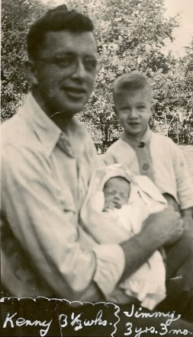
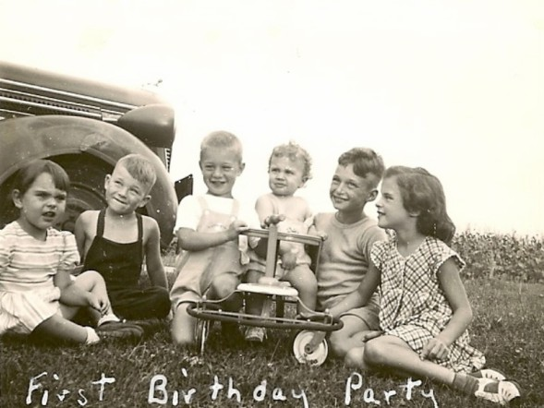
Who Am I?
My name is Ken Connor
I was born in Madison, WI

Slide 5
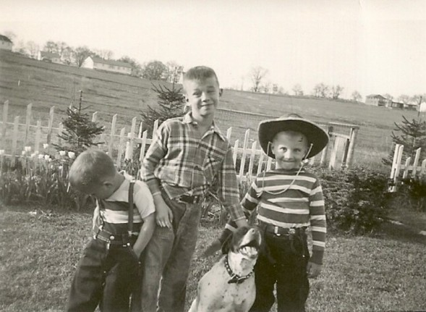
Who Am I?
My name is Ken Connor
I was born in Madison, WI
I have two brothers

Slide 6
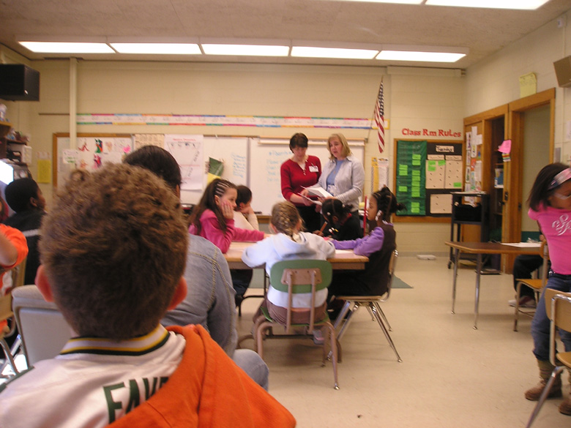
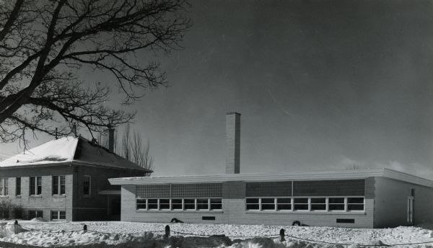
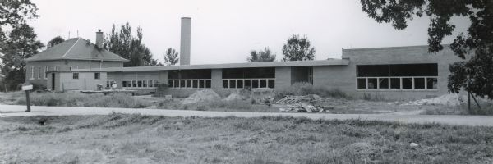
Who Am I?
My name is Ken Connor
I was born in Madison
I have two brothers
I attended Mendota School from 1952 – 1958

Slide 7
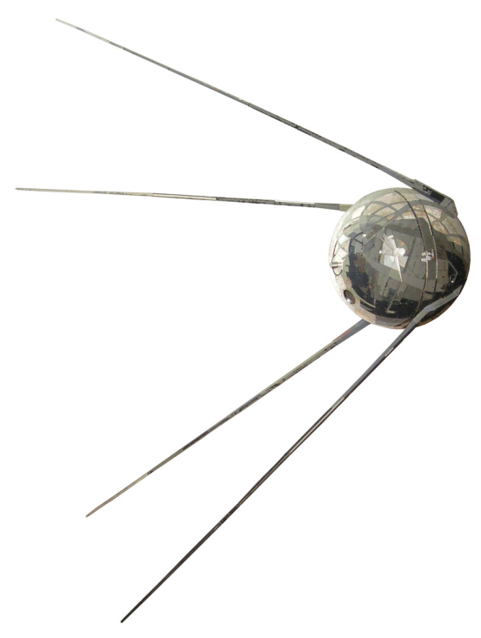
Why am I an Engineer?
October 1957 – Sputnik 1 (Спутник-1)
6th Grade Class – 4 students selected for advanced studies
7th & 8th Grade Math & Science Combined
Began HS Math & Science in 8th Grade
Diameter = 58.5 cm
Inside
Sounds
http://www.nytimes.com/interactive/2007/09/24/science/space/20070924_SPUTNIK_GRAPHIC.html#tab1
http://www.mentallandscape.com/Sputnik1_WashingtonDC.mp3

Slide 8
Me
29 March 1958

Slide 9
?

Slide 11
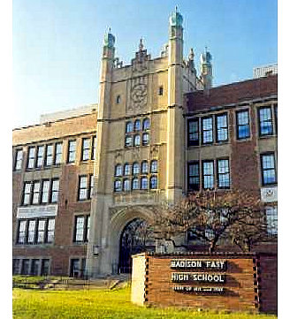
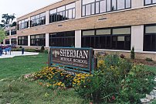
Who Am I?
My name is Ken Connor
I was born in Madison
I have two brothers
I attended Mendota School from 1952 – 1958
I attended Sherman Junior High School from 1958 – 1961
I attended East High School from 1961 - 1964

Slide 12
Who Am I?
I attended the University of Wisconsin from 1964 – 1970 receiving two degrees in Electrical Engineering

Slide 13
Why am I an Engineer?
Why did I go to engineering school when none of the other three accelerated students from my elementary school did?
My theory – my dad was the ‘go to’ person for our extended family … if anyone had a problem they could not solve, they asked him to help. This made his sons problem solvers … it does not matter what the problem was, we do our best to find a solution.

Slide 14
Who Am I?
I attended the University of Wisconsin from 1964 – 1970 receiving two degrees in Electrical Engineering
I attended the Polytechnic Institute of Brooklyn (in New York) from 1970 – 1974 receiving a PhD in Electrophysics

Slide 15
Who Am I?
I attended the University of Wisconsin from 1964 – 1970 receiving two degrees in Electrical Engineering
I attended the Polytechnic Institute of Brooklyn from 1970 – 1974 receiving a PhD in Electrophysics
I have been a professor of Electrical Engineering at Rensselaer Polytechnic Institute in Troy, NY since 1974.

Slide 16
How Many Years of School is That?
6 Years Elementary (no K)
3 Years Junior High
3 Years High School
10 Years College
36 Years Teaching
22 Years
I really love school. I like what it has made it possible for me to do.

Slide 17
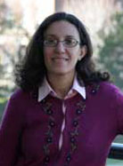
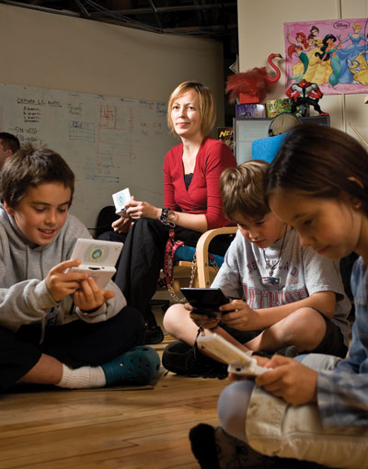
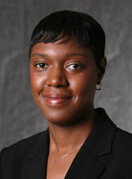
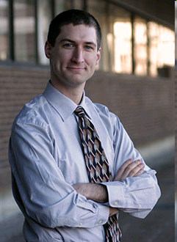
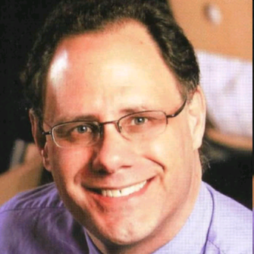
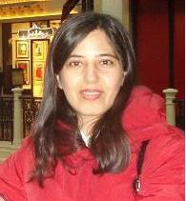
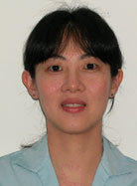
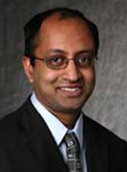
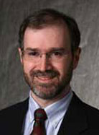
I Get to Work with Really Great People
Professors in My Department
Tobi Saulnier – Founder of 1st Playable

Slide 18
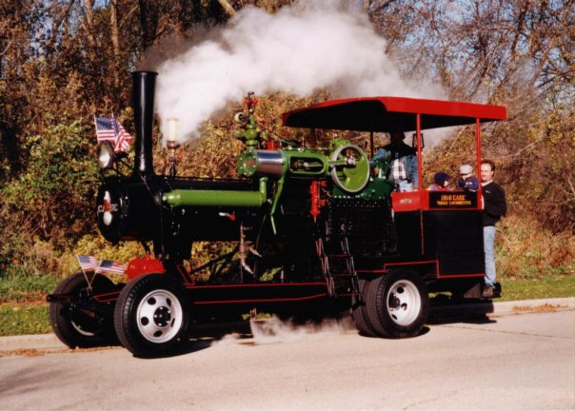
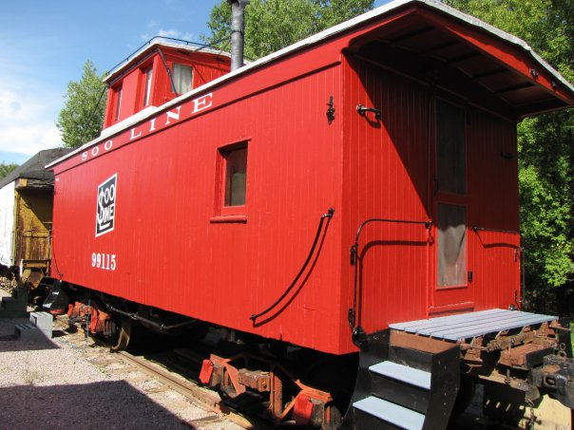
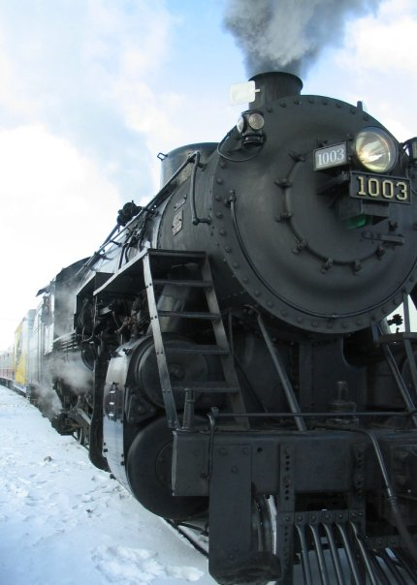
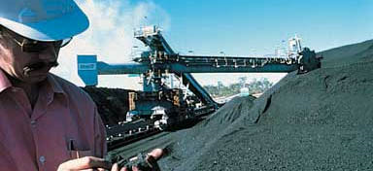
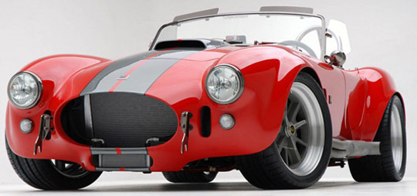
My Brothers Today
Metso Minerals Industries, Inc.
Mining Services North America

Slide 19
Why Be an Engineer?
Engineers make a world of difference
Engineers are creative problem-solvers
Engineers help shape the future
Engineering is essential to our health, happiness and safety
From the NAE

Slide 20
NAE Study
It is a good idea to read at least the executive summary of this document, which is free online, but cannot be fully downloaded for free.
http://nae.edu/nae/naepcms.nsf/weblinks/MKEZ-7FWNXE?OpenDocument

Slide 21
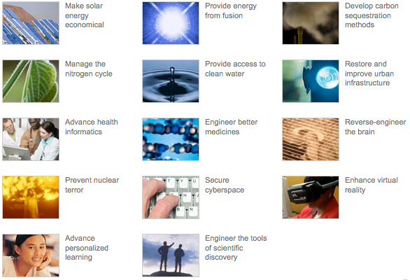
Grand Challenges

Slide 22
Grand Challenges
Download the report
Watch the PR video
Select your favorite challenge
http://www.engineeringchallenges.org/cms/challenges.aspx

Slide 23
Thinking Like an Engineer
There are many resources available from professional societies, etc.
From the ASME, for example.
ASEE has extensive K-12 support
Links I have collected
http://hibp.ecse.rpi.edu/~connor/EOD/
Historical Connection – Theodore Judah
http://cprr.org/Museum/Judah_Report_1863.html

Slide 24
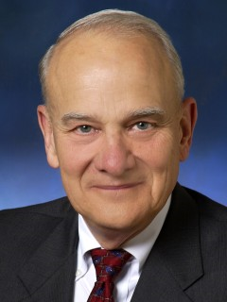
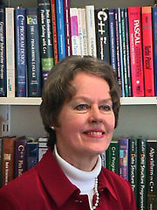
Thinking Like an Engineer
Prof. Bill Wulf – former head of NAE, now back as CS Prof. at Virginia
His wife, Prof. Anita Jones is also in CS at Virginia & has worked for DOD.
He offers a course called “Responsible Citizenship in a Technological Democracy”

Slide 25
Responsible Citizenship
“The United States is the most advanced technological society in the world and many of its most critical public policy issues reflect that – issues such as climate change, energy policy, privacy, and voting technologies, for example. Unfortunately, a large majority of our citizens do not understand enough science and engineering to meaningfully participate in an informed discussion of these issues. Not to be too dramatic – but one has to wonder what it means for a society to call itself a democracy when most of its citizens cannot meaningfully engage in discussion of the major issues facing it!”
Prof. Wulf’s course supplies those concepts and mental tools most often needed to think about the technological dimensions of public policy issues. No math or science prerequisites and no equations are used; rather, he stresses the concepts. We will use a bit more math and science, but still not a lot.

Slide 26
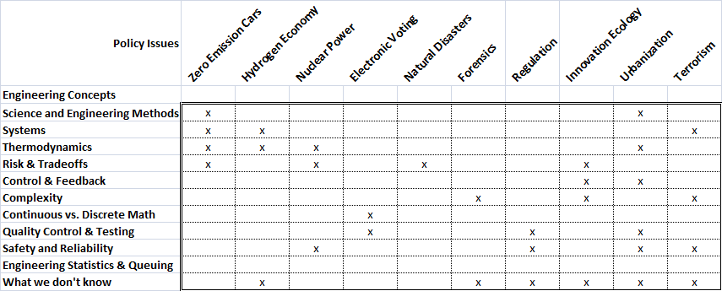
Example Issues
We will address a few of the energy related issues from his course.

Slide 27
The National Academies
“Over the period from 1863 to today the Academies have developed a reputation for producing fact-based, authoritative, unbiased answers to some quite sensitive questions. Generally the questions we’re asked are one of two types:
Purely technical questions. The batteries and other components of the Hubble Space Telescope need to be replaced or it will cease to work around 2010. In the wake of the Challenger shuttle accident, the Administrator of NASA decided that sending up the shuttle to service Hubble was too dangerous, so it would be done robotically. The question to the Academies was whether a robotic mission was feasible. The answer was “no!”. We were not popular with the Administrator, but the technical argument we made was convincing, and so he reversed his decision.
Policy issues that need to be informed by the state of science/engineering knowledge. A few years ago Congress was considering an energy bill and asked the Academies whether it was feasible to increase the CAFÉ standards. CAFÉ stands for Corporate Average Fuel Economy, and is a late 70’s law that requires that the average fuel consumption of the fleet of cars sold by a manufacturer be greater than some threshold. That threshold had not been changed since the original law was passed almost thirty years ago. Our answer was “yes”, they can be increased at a reasonable cost. At the time, in its “wisdom”, Congress did not increase the standards – but in the most recent bill they did.

Slide 28
Example Questions
Is the “hydrogen economy” a good idea? Why?
The two atomic bombs dropped on Japan at the end of WW II, by some estimates, killed 80,000 outright from blast effects and exposed another 80,000 to “significant” radiation. How many of those exposed to significant radiation would you estimate later died due to that exposure? (The more technically correct form of this question is “how many more people died than one would expect in a similar population that had not been exposed to this radiation?”.)
A few years ago, Congress repealed the “Delany Clause” – a provision that prohibited sale of foods that contain cancer-causing substances. Should this provision be reinstated?

Slide 29
Example Questions
Some years ago, in the face of a mounting air pollution situation, California required that a certain fraction of the cars in the state be “zero emission” (i.e., electric). Should the rest of the states adopt such a policy?
In the wake of the 2000 “butterfly ballot” election fiasco in Florida many localities switched to computer-based voting systems. However, concerns have been raised about the possibility of errors in these systems because of either unintentional mistakes or intentional “hacking”. Should Congress mandate complete testing of these systems to prove their correctness/accuracy before they are used?
The Earth’s supply of petroleum is clearly finite. When do you estimate that we will begin to experience economic disruption because of this? When will we “run out” of oil?

Slide 30
Example Questions
In the wake of 9/11 we have all become more aware of the possibility of catastrophic terrorism in the U.S. Which do you personally find the scariest: biological, radiological, chemical or nuclear terrorism? Something else? Why?
Around the beginning of the 20th century, the U.S. passed “anti-trust” laws to prevent unfair “price gouging” by companies that have a monopoly position in a market. If found to be such a monopoly, offending companies can be “broken up” into a set of smaller companies – a successful use of this was the 1984 break up AT&T into a long-distance company and 7 regional operating companies, for example. A more recent case against Microsoft failed; what is different? Doesn’t Microsoft have a monopoly since Windows (and Office) runs on more than 90% of PCs?

Slide 31
Example Questions
Some people, especially in Europe, are proposing strict application of the “precautionary principle” – the idea that no technology should be adopted until it has been proven to have no negative effects. How should we react to this?
In the past the earth has been hit by large asteroids with catastrophic results (as in the case of the extinction of the dinosaurs). Should we deploy a system to destroy (or deflect) such asteroids? Why?
There is a debate on whether we should store “high level” nuclear waste at Yucca Mountain; should we? Why?

Slide 32
Example Questions
There are many proposals for “renewable” energy sources to replace fossil fuels– wind, solar, geo-thermal, wave, hydro, biomass, etc. Isn’t this a “no brainer”?
For missions that will travel too far from the sun to use solar cells for power, NASA plans to use plutonium-based nuclear power plants on these missions. Given that rockets blow up from time to time, is this safe?
We currently get about 20% of our electricity from nuclear power plants. Should we increase or decrease this? Why?

Slide 33
Example Questions
Burning ethanol (in vehicles, for example) produces CO₂, but in the US ethanol is produced from corn and as the corn grows the process of photosynthesis removes CO₂ from the atmosphere. In short, there is no new CO₂ introduced – and indeed, in net maybe even a little is removed. Shouldn’t we be pushing for a massive switch from petroleum-based fuels to corn-based ethanol?
This isn’t a public policy question, but have you noticed that at the grocery store you queue up for a particular cash register, but at the bank there is generally one queue and the person at the head of it goes to whichever teller becomes free next? Why the difference? In fact, does it make a difference?

Slide 34
Example Questions
This isn’t a public policy question either, but what is the purpose of the brakes in your car? If you are an engineer, or responsible for certain public policies, it’s really important that you get the answer to this right!
Recently (November of 2006) the EPA, concerned about unanticipated negative effects of nano-technology, banned the sale of products containing nano-sized silver particles as anti-microbial agents unless they could be shown to have no negative impact on the environment. Bravo to the EPA, right?

Slide 35
Example Questions
Trace amounts of other elements can be measured with extreme precision in the lead used to make bullets. Thus, for many years, the lead in the bullets used in a crime were compared to those found, for example, in a suspect’s possession. These comparisons were used as evidence in trials to prove the guilt or innocence of the suspect. Recently, however, the courts have disallowed bullet lead evidence. Is somebody off their rocker? There is no question that the comparisons are precise enough to unambiguously determine whether two bullets came from the same batch of lead, so why are the courts giving up this tool to convict guilty persons?

Slide 36
Example Questions
Some people now carry their own cups to Starbucks rather than use the paper ones provided by the coffee vendor. This saves paper (hence, trees) and reduces the amount of material added to land fills. Shouldn’t we all do this?
Despite 20+ years of talking about the poor quality of K-12 education in the US, and the demonstrably terrible performance of our students compared with those from other countries, things have only gotten worse. When are we going to bite the bullet and fix the system?

Slide 37
Thinking Like an Engineer

Slide 38
Thinking Like an Engineer: Systems
What is a system?
Can we think of any examples?
Concept: A system is something made from a collection of simpler things – usually called components, parts, or subsystems. Each part has a function and the collection of parts have relations among them that let the assemblage accomplish some larger function.

Slide 39
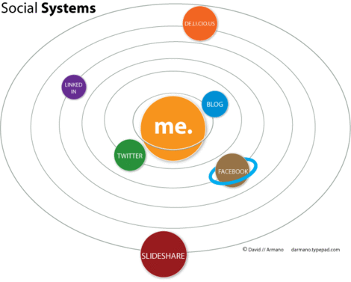
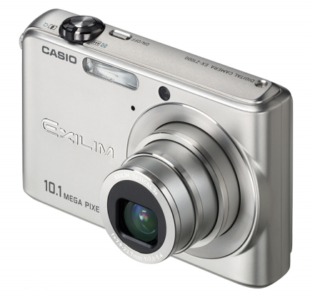
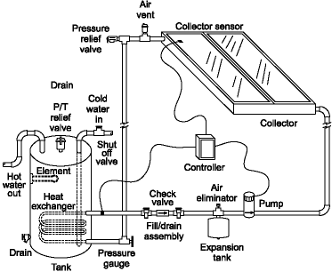
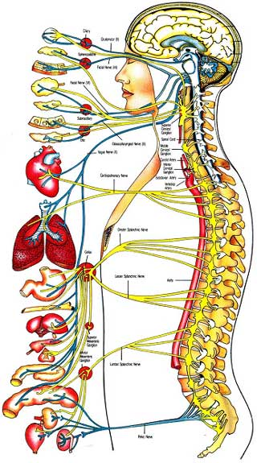
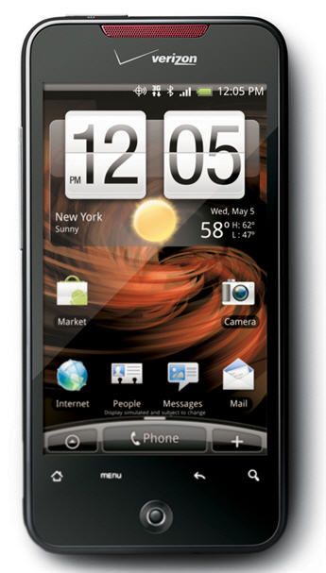
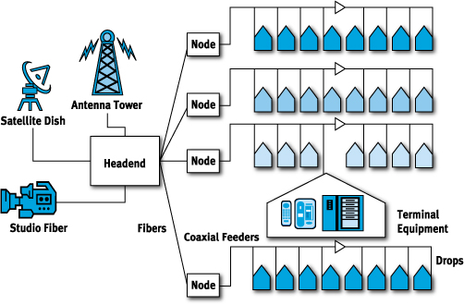
Systems Examples

Slide 40
Systems Concepts
Concept: A crucial characteristic of a good system design is that you can understand how the whole works by knowing just what its components do and their relationship to each other, but not how they do what they do.
The concept of a system is useful in designing things as well as in analyzing how an extant system works. Let’s consider design first. When engineers design a complex device – say the next commercial airliner from Boeing – they will first describe its components (wings, engines, etc.) and how they interact at a fairly abstract level. Then separate design teams will be assigned to the separate components and, in parallel, the teams will consider alternative implementations for their component. Since something like a commercial airliner is very complex, it’s likely that this process of “system decomposition” and design will proceed through many levels before concrete decisions will be made. But in the end, the idea is to find the best implementation of each component.

Slide 41
Systems Concepts
Concept: To evaluate whether one implementation of a component of a system is better than another, you must evaluate the two in the context of the whole system in which they will be a part.
A refrigerator is a refrigerator, right? Well, yes, but the best refrigerator for an ocean liner and the best refrigerator for the space shuttle will be very different. The one for the ocean liner will be big, and its weight and power consumption won’t matter much. Exactly the opposite is true for the one for the space shuttle. Moreover the “operating environment” in space is cold, so there may be some design options available to the designer of the shuttle refrigerator that aren’t available to the designer of the ocean liner refrigerator. The point is that what makes one design of a component better than another comes from the context of the system within which it is used. There is no universal “best” for all contexts.

Slide 42
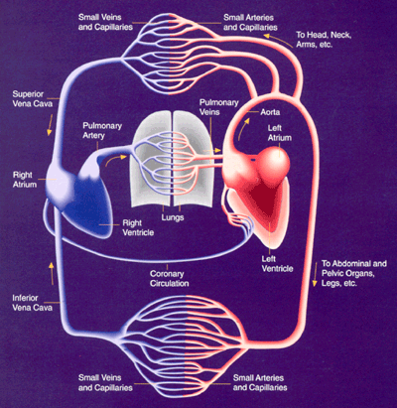
Natural Systems
Most natural objects are systems. Our bodies are systems with components such as the circulatory systems, the lungs, the liver, etc. Many of these are also a system, so our bodies are really an example of a system of systems. As with the artificial systems built by engineers, to understand the macroscopic operation of the body we only need to know what each subsystem does, not how it does it. Only when we want to know, for example, how a subsystem such as the heart works do we need to learn about its various chambers and valves.

Slide 43
Systems Concepts
Concept: There is no answer to the question “is A better than B” unless you know the larger context, the system, in which A or B will be used and how A or B will interact with the other components of that system!
Example: Using hydrogen as a transportation fuel. The usual rationale is that when hydrogen burns the result is pure water, so no pollution. That’s true, but it’s not the whole story. Hydrogen isn’t something that you can pump out of the ground; it has to be made. A hydrogen-powered vehicle, then, is part of a larger system that includes at least the process of making hydrogen, transporting it to where it will be used, storing it on board the vehicle, and perhaps more. Whether using hydrogen as a transportation fuel is a good idea depends on whether all of these things taken together are a good idea.
Example: Is an electric car better than a gasoline car?

Slide 44
Systems Concepts
Concept: State of a System
You may hear engineers talk about the “state” of a system. What they are talking about is what’s going on at a moment in time in each of the components. If your body is the system under discussion, for example, it’s “state” includes your current heart rate, your current blood pressure, your current temperature, whether you are awake or asleep, and so on
It’s the nature of any system that what happens next is a function of what’s happening now plus an external stimulus. So it’s convenient to talk about what’s happening now as the “state” of the system, and what will happen next as its “next state”.

Slide 45
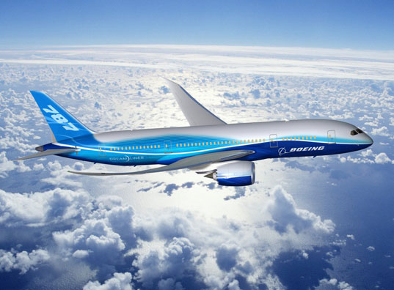
Systems Concepts
Concept: Levels of Abstraction
One starts with a quite abstract description.
So, you want a plane to carry 200 passengers. OK, we’ll need a fuselage about so long and so wide. That means, based on experience, that it will weigh about so much. So, we’ll need wings to provide enough lift that much weight plus themselves, and engines to provide so much thrust. …
Then each of these components will be described a little more concretely, but still pretty abstractly.
OK, if the wings are to provide so much lift, they will need to be so long, so wide and have a cross-sectional profile of thus and so. Now we can get a better estimate on the weight – did we get it “close enough” in our previous estimate?

Slide 46
Systems Concepts
Concept: Levels of Abstraction
After many such levels of increasing specificity, things will finally become very concrete:
This wing strut must be 1/8th inch type X aluminum and must be attached to that cross brace with number 8 steel rivet …
The purpose of this multi-levels of abstraction is partly just to keep intellectual control of the complexity of the design, but it’s also the case that different kinds of analysis are appropriate at different levels of abstraction. To calculate the range of the new airliner, for example, only some abstract properties are needed – the weight of the plane, the drag on it, the fuel capacity, etc. What the wing struts are made of, or how they are fastened to the cross braces are irrelevant. On the other hand, if you want to know the safety of the wing in violent turbulence, the details of the design really matter!

Slide 47
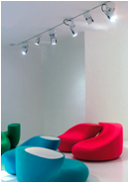
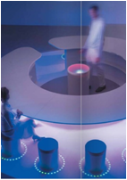
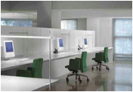
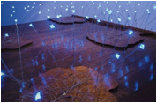
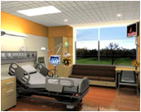
Smart Lighting ERC
A Top Down Vision
Comfort
Health
The Right Light where you want it
Therapeutic Lighting
Energy Efficient Lighting Systems
Lighting Systems interfaced to external
grid & building systems
Adaptive Lighting Systems
Lighting and Data at the same time
Productivity
Information

Slide 48
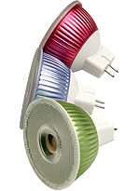
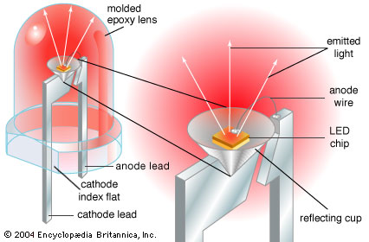
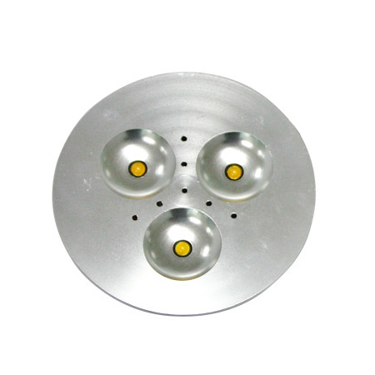
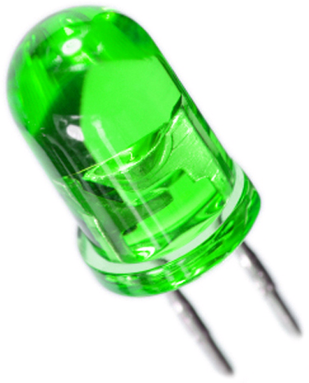
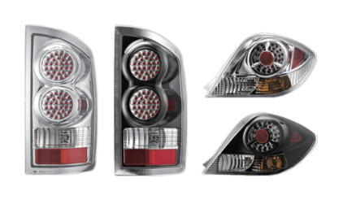
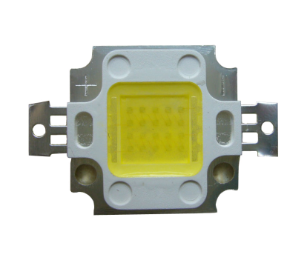
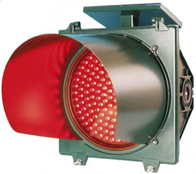
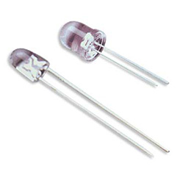
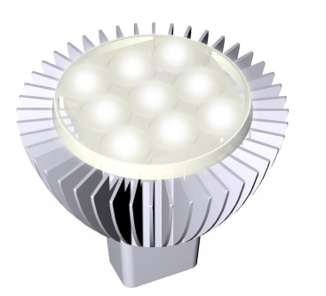
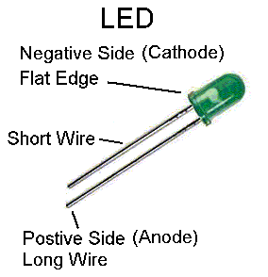
Solid State Lighting

Slide 49
3 Level Diagram
Systems Integration and Translational Applications
A1.1: ROOMS, BUILDINGS
AND ARCHITECTURE
Productivity
Efficiency
Special Needs: Eldercare
A1.2: INFRASTRUCTURE
AND INFORMATION
Transportation
Communications
Smart Grid Interface
A1.3: HEALTH AND
BIOSENSING
Biohazard Tracking
Bioanalysis Lab
Circadian Rhythm
Enabling Technologies
T2.1: SMART
SPACE TESTBED
T2.2: COMMS
TESTBED
T2.3: BIOSENSOR
TESTBED
REAL WORLD
SYSTEM REQUIREMENTS
TECHNOLOGY SOLUTIONS
OVERCOME BARRIERS
T1: SYSTEMS TECHNOLOGIES:
CONTROL AND COMMUNICATIONS
Fundamental Science: Materials and Device Research
S1: PHOTONIC
SOURCES
S2: PHOTONIC
SENSORS

Slide 50
More to Come

